Slide 1
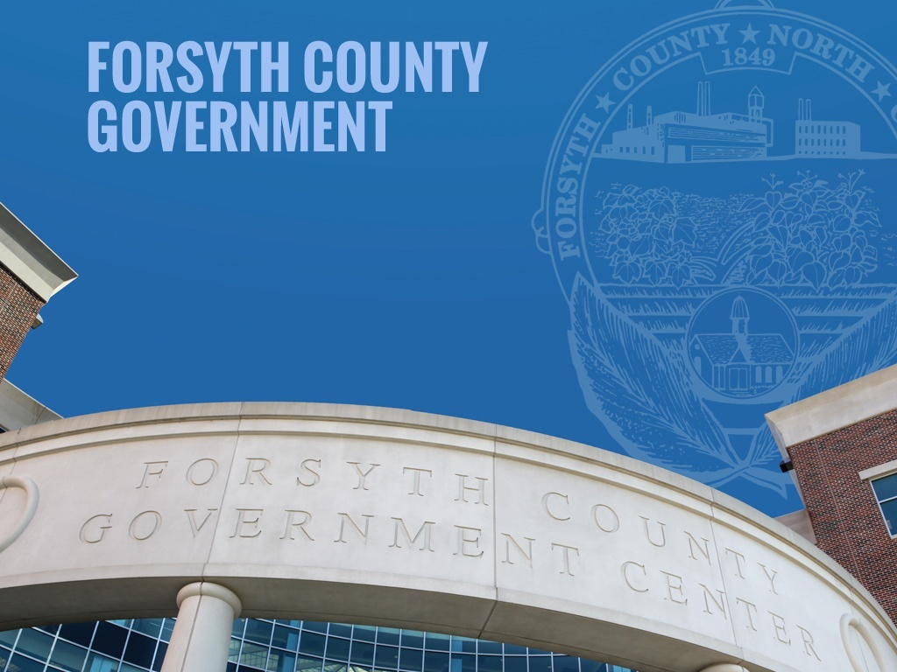
Capital Projects Update
BOCC Morning Session
October 26, 2023

Slide 2
General Services Update

Slide 3
Active Projects
23 projects that are currently in the planning, design, construction, or closeout phases.
12 CIP Projects, 5 CRP Projects, 4 special projects and 2 ARPA Projects
Current project budgets total approximately $224.8M
Individual project budgets range from $100k to $106M
Anticipated Project completion dates extend into 2025

Slide 4
Capital Renewal Plan Projects

Slide 5
Reroofing Projects
DSS Reroofing
REI Engineers was selected to provide design services for the project. Anticipate bidding the project Q1 2024.
Budget $2M
Walkertown Library Reroofing
Atlas Engineering selected to provide design services for the project. Anticipate bidding the project Q1 2024.
Budget $450k
Youth Detention Center Reroofing
Project was designed by Wolf Trail Engineering and is currently out to bid. Anticipate work starting Q1 2024.
Budget $450k

Slide 6
LEDC Projects
Elevator Modernization Project
ArchSTUDIO7 is proposed to be selected for the project to provide design services
Project includes the modernization of 8 elevators and 2 dumbwaiters.
Budget $2,500,000 from special appropriation and $250,000 from 2/3 Bonds
Lock Replacement Project
Project is currently out to bid; will replace locks on swinging doors with a new surface mounted lock body that will reduce inmates' capabilities of jamming the lock assembly.
Budget $2M from Courthouse Project Savings

Slide 7
CRP Challenges
Post Covid Construction Market
Costs have doubled and tripled depending on market segment. Roofing pre-covid $15/sq ft; post covid $45/sq ft
Material lead times remain problematic for HVAC and Electrical systems.
LEDC needs continue to strain limited funding.
LEDC planned and deferred needs for current year are $12.7M
Prior to covid we were projecting a $15M budget gap over 10 years; current projection is $36M funding gap
Building needs are being compressed as items are continuing to be deferred. Current year has $29M in planned and deferred needs, with overall 10-year needs totaling $48M

Slide 8
Capital Improvement Plan Projects

Slide 9
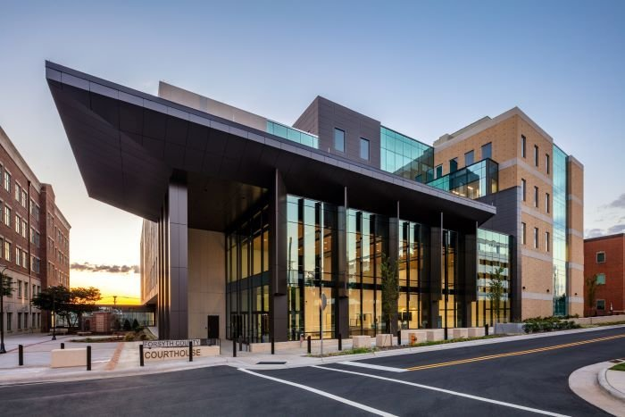
New Courthouse
New 240,000 square foot facility to replace the 170,000 square foot Hall of Justice Facility. The design featured numerous security, public experience, and accessibility enhancements compared to the current facility.
Status: In Closeout
Budget: $105M
Funding: Bond

Slide 10
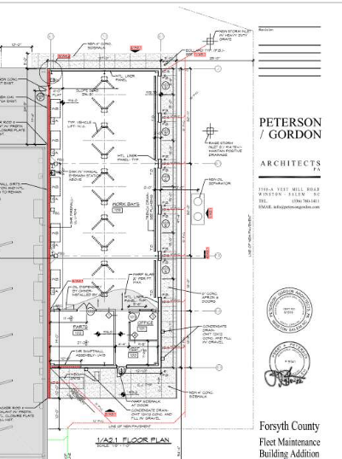
Fleet Expansion
Approximately 3,000 square foot addition to the Fleet Maintenance Facility at the Linville Maintenance Complex. The addition allows collocation of the WSFCS Fleet Maintenance and Forsyth County Fleet Maintenance. The design features 5 additional service bays, parts storage, and an office for the WSFCS Fleet Manager.
Status: In Construction
Budget: $1M
Funding: Pay-GO

Slide 11
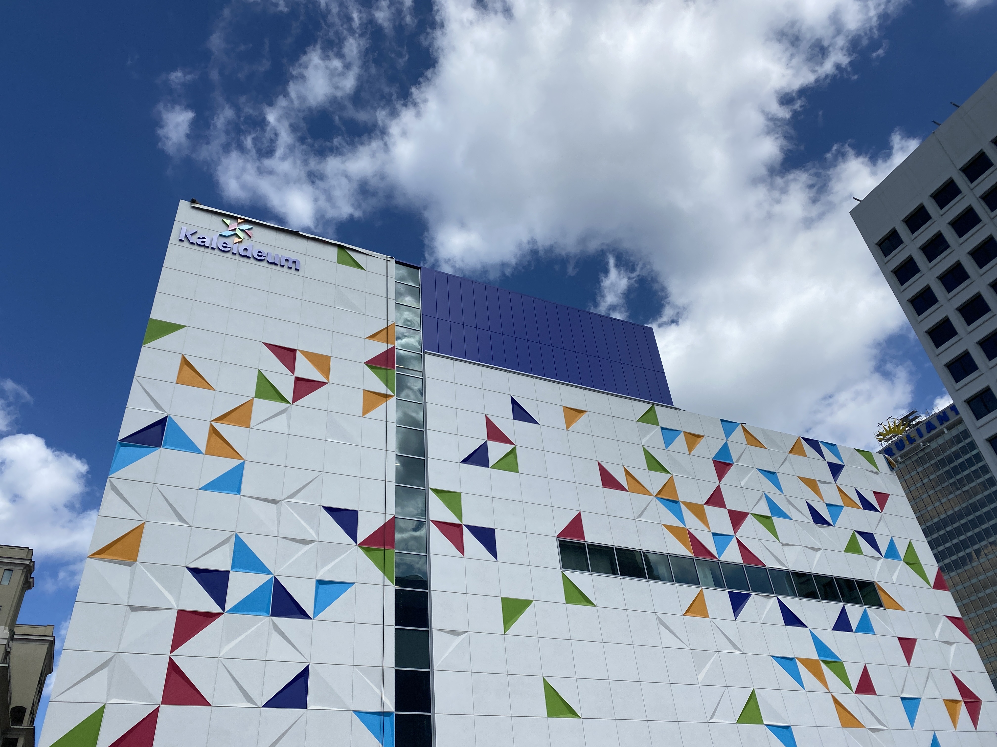
Kaleideum
New 70,000 square foot facility to house the museum formed by the merger of the Children's Museum and SciWorks. The facility is 5 floors with water, early learning, animal, and STEM exhibit spaces.
Status: In Construction
Budget: $30.5M
Funding: Bond and Pay-Go

Slide 12
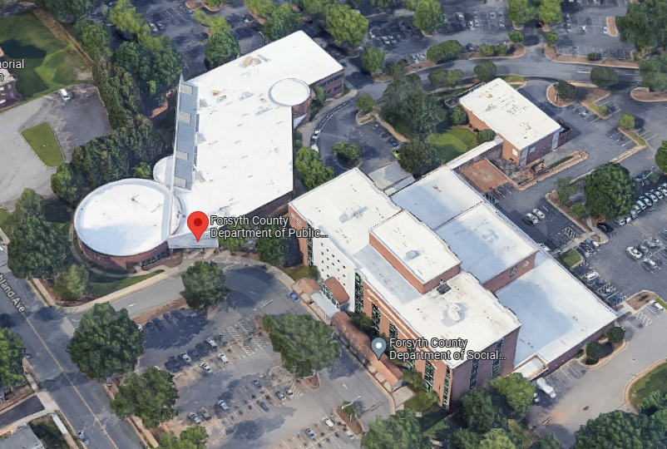
Health Campus Renovations
Project consists of a renovation on the 1st Floor at DSS to expand the public lobby and upfit of a former file room to provide client meeting areas for DSS and WIC. The Public Health scope and budget will be brought back to the Board once Norwood Architecture has completed and provided an estimate for the schematic design.
Status: In Design
Budget:
DSS: $450,000
Public Health: TBD
Funding: Pay-Go

Slide 13
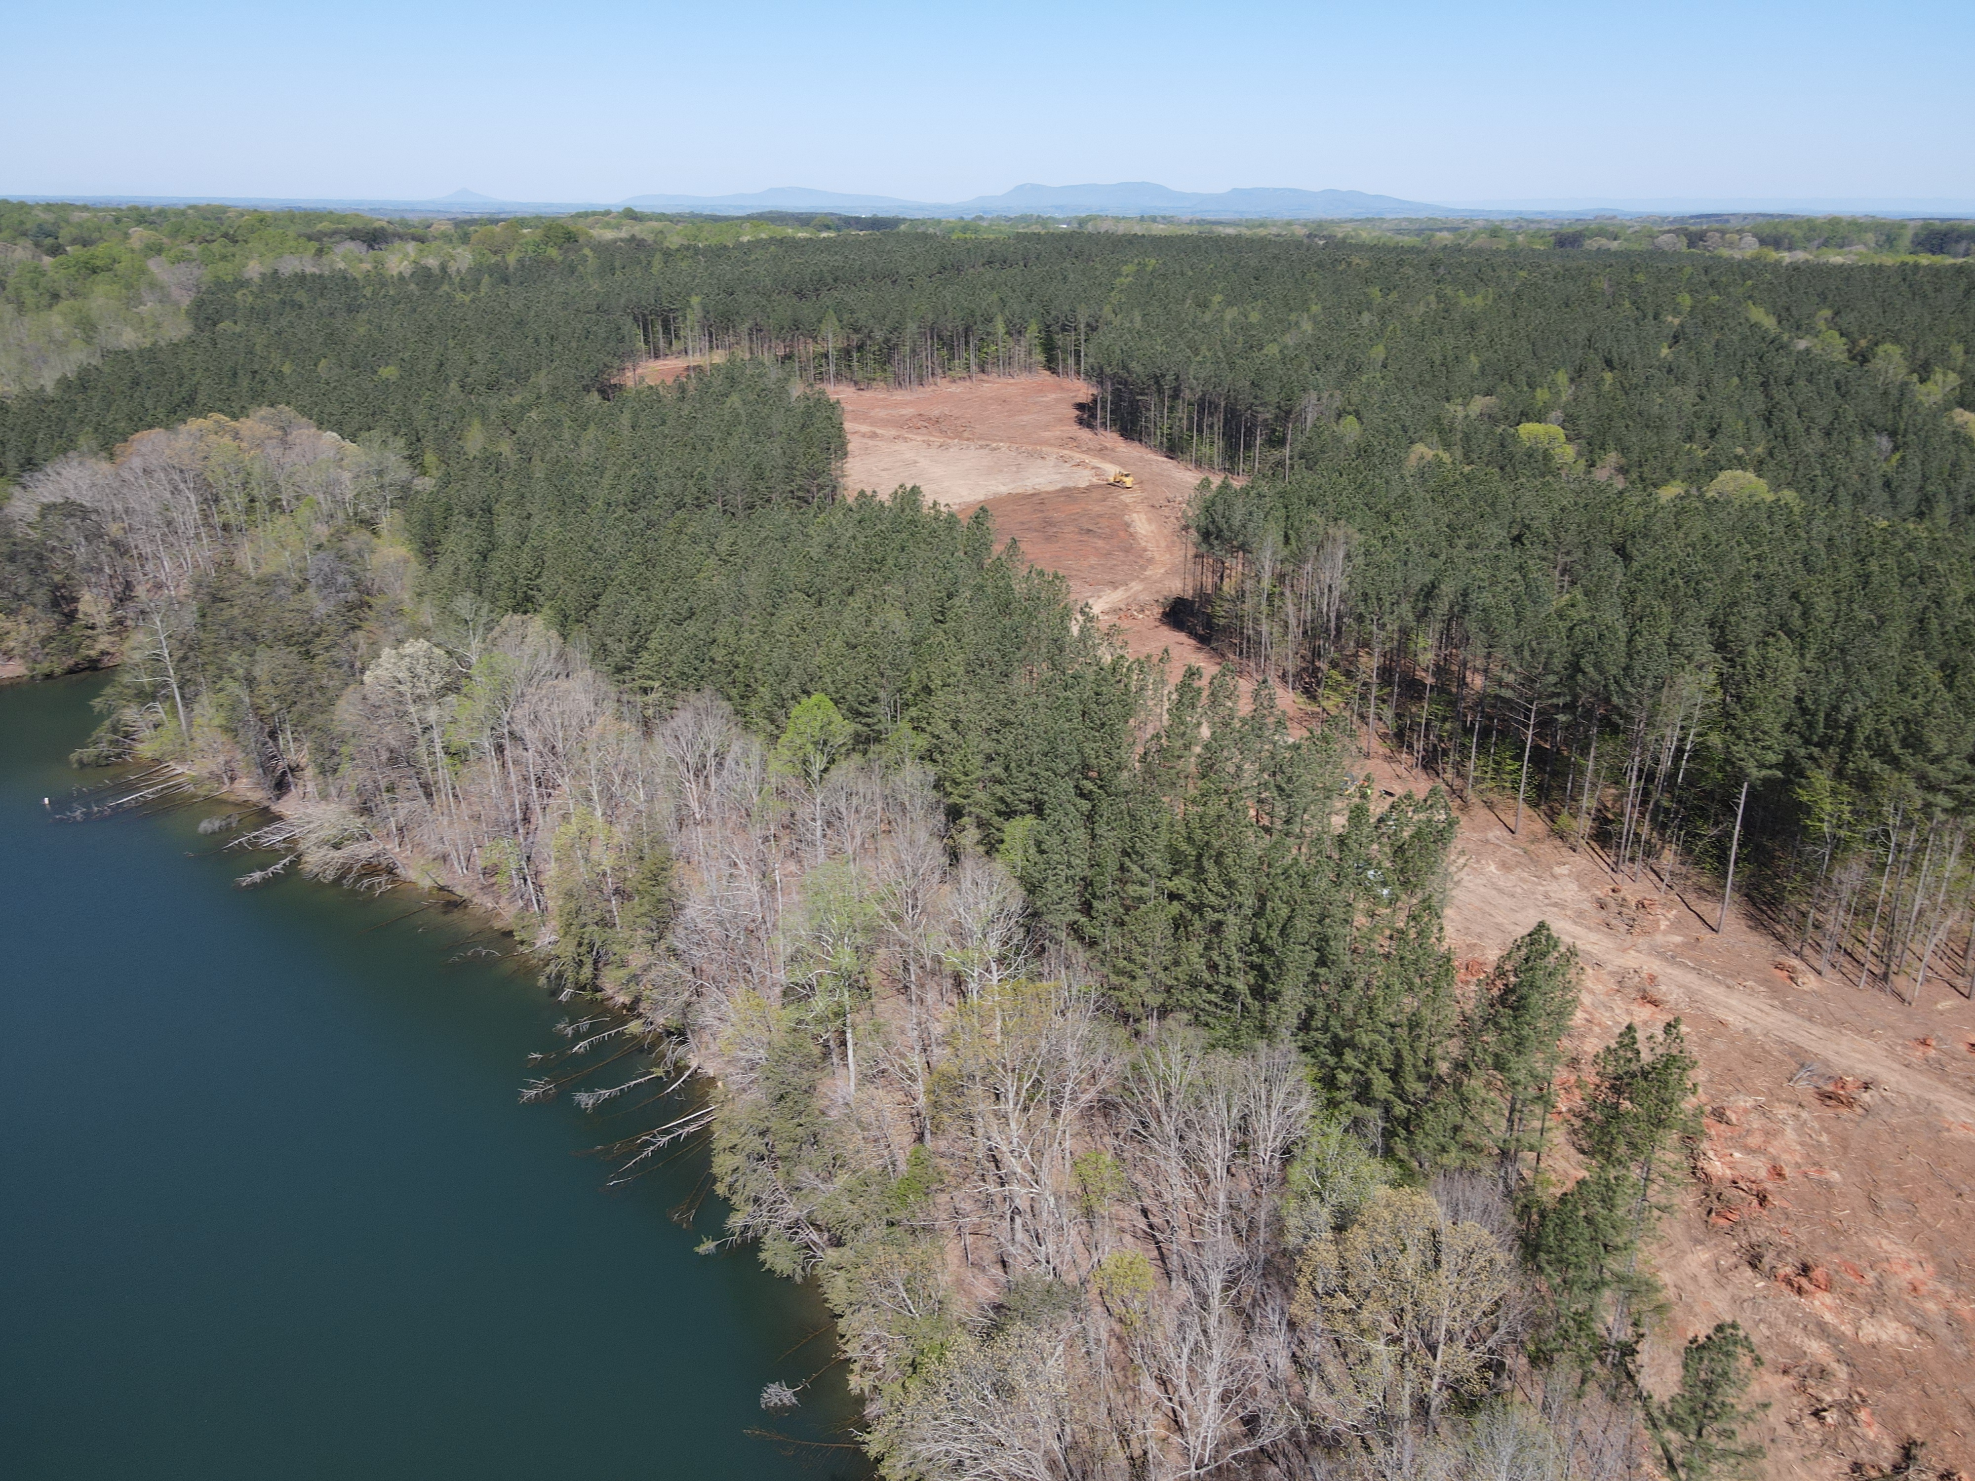
Belews Lake Park
New park facility located on the shores of Belews Lake in the Northeast corner of the County. Phase I of the project includes multi-modal trails, picnic areas, a shelter with comfort station, a maintenance facility, and fishing docks.
Status: In Closeout
Budget: $6.6M
Funding: Bond, state funds, and Pay-GO

Slide 14
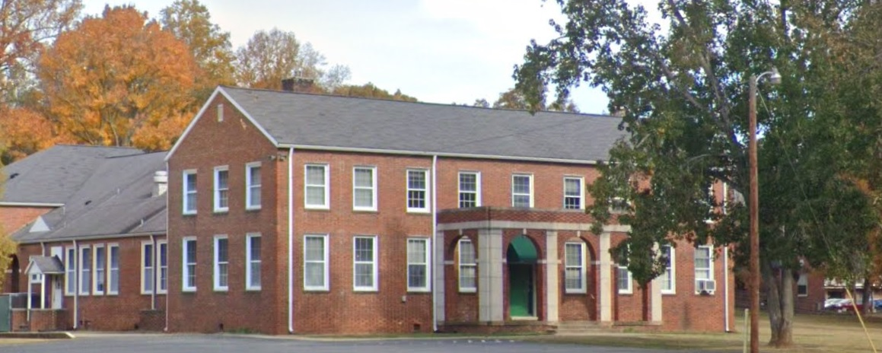
Horizons Park Administration
Renovation to the Administration Building at Horizons Park to reactivate the facility as a community center. The project will include replacing the roof, new HVAC systems, interior finishes, ADA updates, new electrical systems, and updating life safety systems.
Status: In Design
Budget: $1M
Funding: Bond

Slide 15
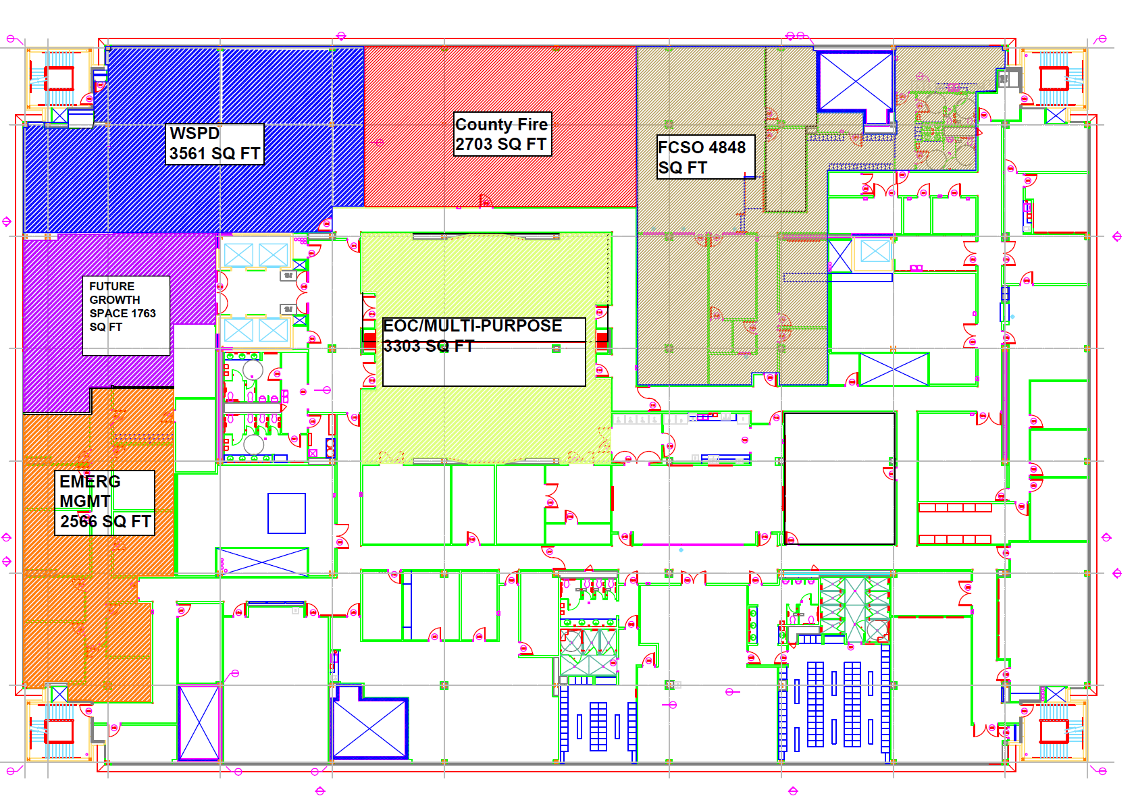
PSC Reorganization
Project to upfit approximately 10,000 square feet on the 3rd Floor of the Public Safety Center for the FCSO Administration Offices. This is phase 1 of the project to collocate WSPD communications with Emergency Services and FCSO Communications. Vacated space will also accommodate expansion for Emergency Management.
Status: In construction
Budget: $1.4M
Funding: Pay-Go

Slide 16
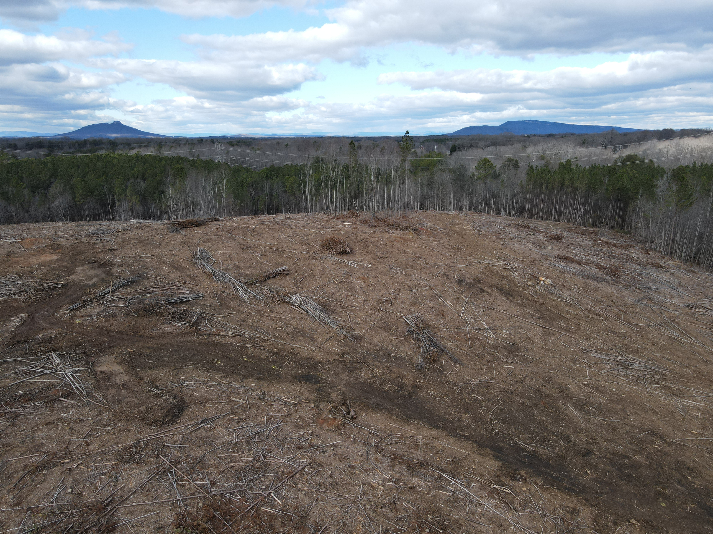
Agricultural Park Complex
Phase I of the project includes initial development of the park including access road, site utilities, Cooperative Extension Facility, trails, and an outdoor riding arena. Future development of the park will include an enclosed arena, additional parking, playgrounds, and shelters.
Status: In Design
Budget: $17M
Funding: Bond, Pay-Go, and State Funding

Slide 17
Tanglewood Clubhouse
Proposed project would replace the existing 1970's clubhouse. The new facility would feature enhanced meeting spaces, full ADA accessibility for guests and staff, pro shop, and grill area.
Status: GMP options presented to the County
Budget:
Option 1 $16.4M
Option 2: $14.9M
Funding: Bond, State and Pay-Go

Slide 18
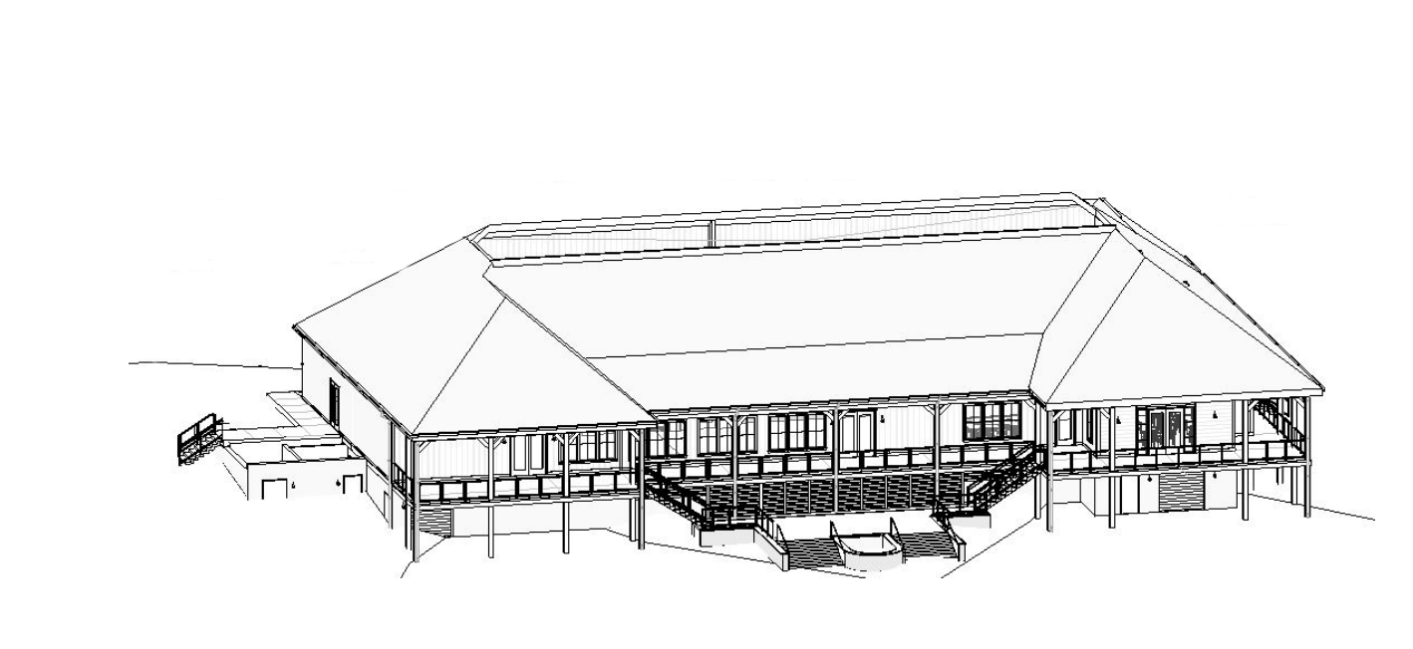
Tanglewood Clubhouse
Option 1 ($16.4M)
Cart storage beneath the building
Elevated back porch/event space when approaching the 18th Green;
Approximate $4.7M Revenue Gap

Slide 19
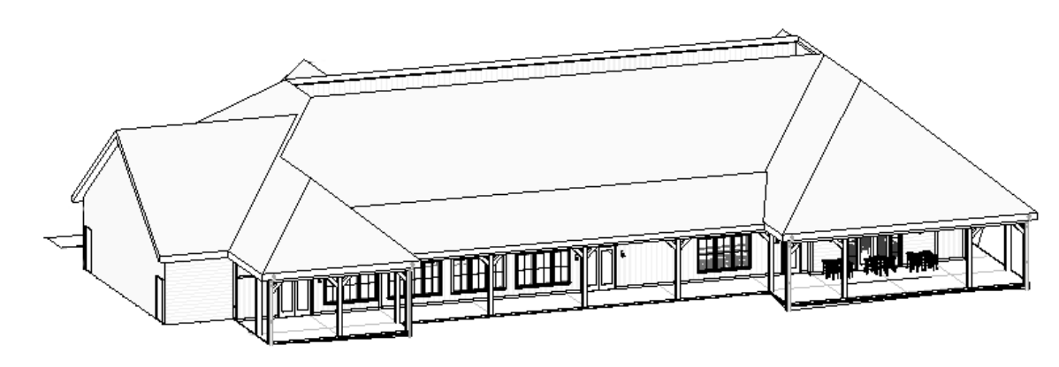
Tanglewood Clubhouse
Option 2 ($14.9M)
Cart storage is separate building in parking area across from the train.
Clubhouse will be on grade when approaching from the 18th green.
Higher operational expenses for staff to stage carts.
Approximate $3.2M Revenue Gap

Slide 20
ARPA Projects
Behavioral Health Campus Renovations
Highland Avenue Center Project
I.L. Long was selected as the Design Builder for the project and is currently bidding the trade packages. Anticipate bringing a Guaranteed Maximum Price Proposal to the Board in November.
Project includes renovation of 1st Floor space to form a behavioral health crisis center, and upfit of shell space on the 2nd Floor for provider offices, counseling rooms, Stepping Up, and Behavioral Health Department Offices.
Budget: $1.9M
Annex 1 Auditorium Renovations
Peterson Gordon Architects was selected to provide design services for the project. Anticipate bidding the project Q1 2024.
Project includes new lighting, interior finishes, and accessibility improvements.
Budget: $400K

Slide 21
Special Projects
Tanglewood Maintenance Solar Project
City/County Purchasing advertised an RFQ for design-builders and Renu Energy Solutions was the only firm to respond. Staff are currently negotiating a fee with Renu for the Project
Budget: $100K
Fleet Electrification
Verifiable Results was selected to provide professional engineering services to design the charging infrastructure. Anticipate bidding this project Q1 2024.
Initial Phase includes 6 charging stations at the Government Center and 6 charging stations at Health Services Campus.
Budget: TBD
Sturmer House Renovations
Stitch Design Shop has completed design documents and staff are coordinating with City/County Purchasing to bid the project.
Scope of work includes adding an exterior stair to provide a second means of egress from the 2nd Floor, interior finishes replacement, new windows, and life safety updates as required to reactivate the facility as a residential care facility for juveniles.
Budget: $120K
Former Cemex Site Demo
Board of Commissioners approved contract with Double D Construction Services at the October 5th Meeting
Scope of project includes demolition of structures and removal of vegetation overgrowth.
Budget: $200k

Slide 22
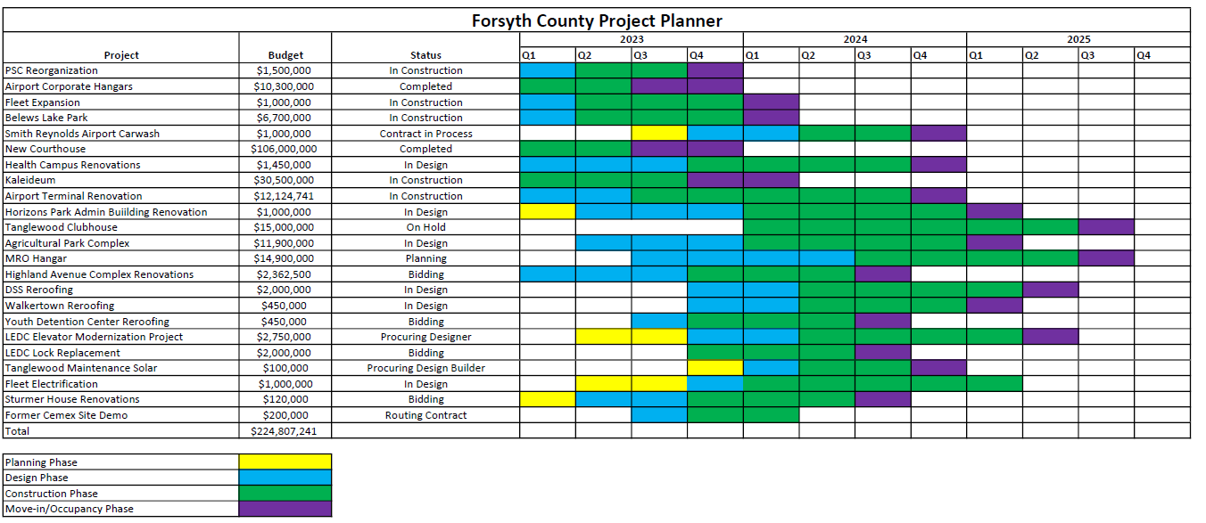
Forsyth County Project Planner

Slide 23
Parks Update

Slide 24
Active Projects
8 projects that are currently in planning or design.
(1) GO Bond projects, (1) 2/3rds Bond project, (5) PayGo Projects, and (1) ARPA Project.
Current project budgets total approximately $6.4M
Individual project budgets range from $175K to $1.4M
Anticipated Project completion dates extend into 2026

Slide 25
Forsyth County Project Planner - Parks

Slide 26
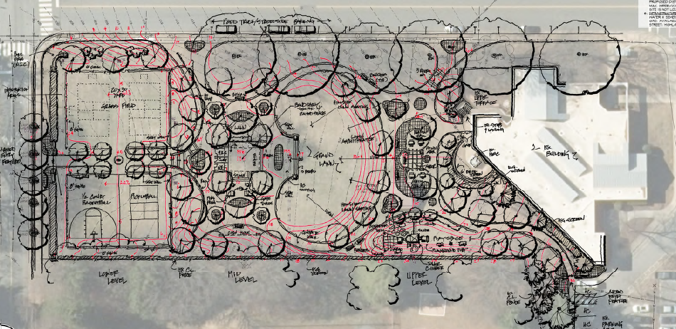
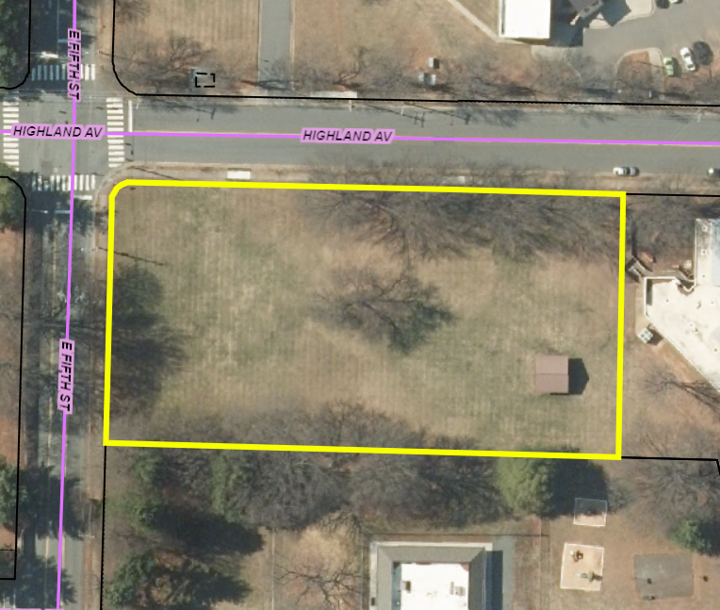
Highland Avenue Park
This is an enhancement project for the HHS Campus. The park will be constructed on the 1-acre open lot located at the corner of Highland and 5th Streets. The project scope includes a handicap accessible playground, a small shelter, open space, game & picnic tables, and small sports courts.
Status – In design
Total budget - $1,400,000
ARPA funding

Slide 27
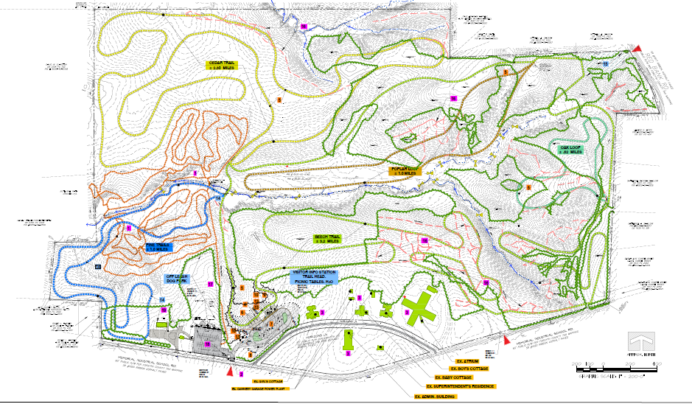
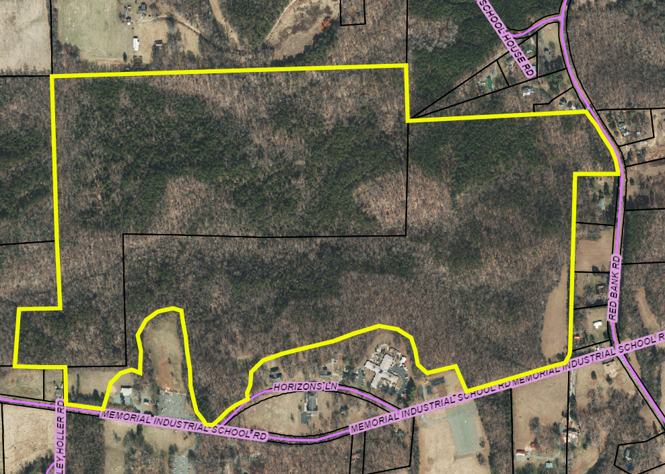
Horizons Park Multi-Modal Trails
This project will develop nearly 8 miles of multi-modal trails on approximately 175 acres north of Memorial Industrial School Road. These trails will be designed primarily for equestrian and pedestrian users.
Status – In design
Total budget - $750,000
2016 General
Obligation Bonds

Slide 28
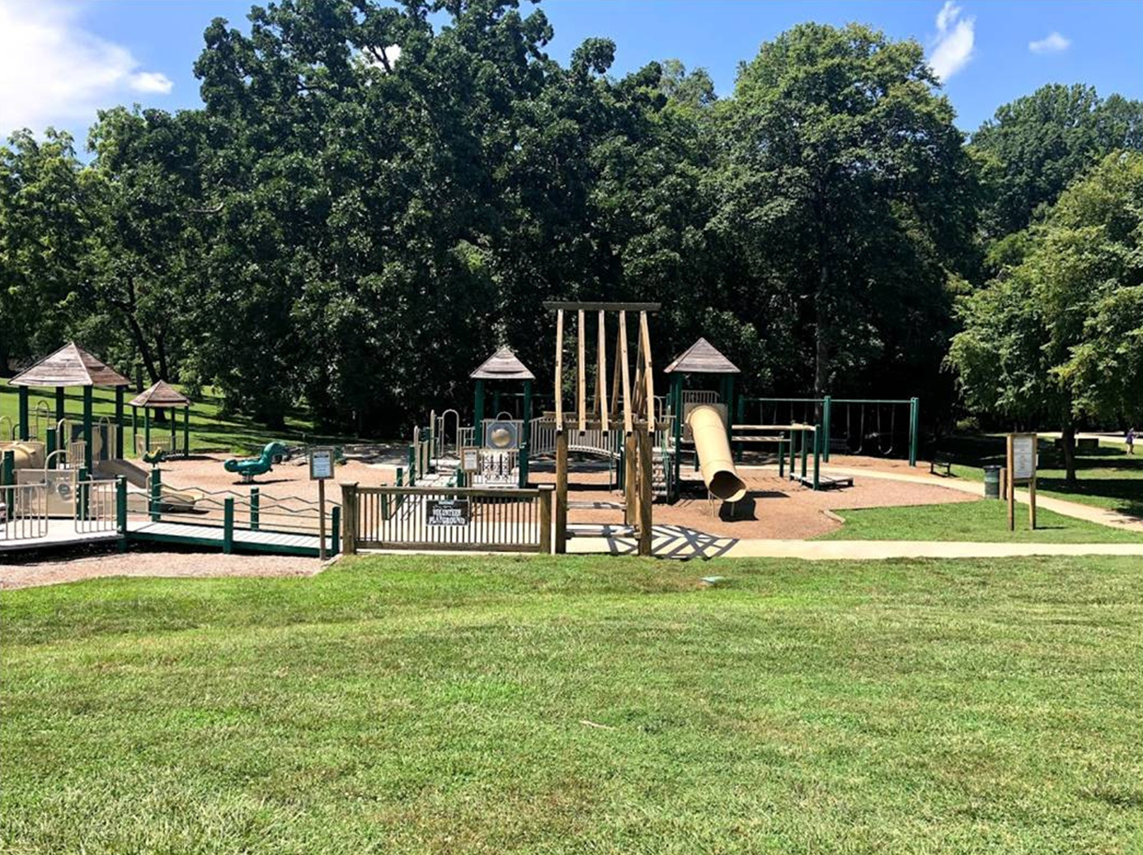
Tanglewood Park - Shelter #4 Playground Replacement
Replace Tanglewood "Shelter #4," a 25-year-old playground. This 10,000 sq ft playground is the largest and arguably the most heavily used playground in the County park system. Repair and replacement parts for this shelter are no longer available. The project scope will provide play structures for 2–5-year-olds and 5–12-year-olds.
Status – In design
Total budget - $570,000
2020 2/3rds Bonds

Slide 29
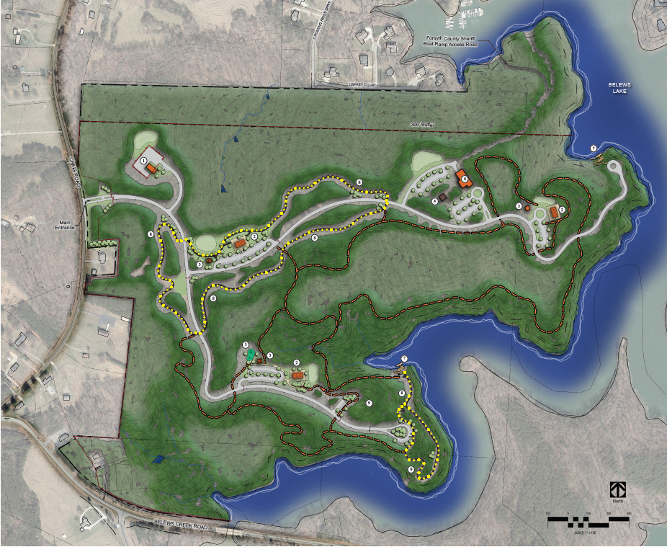
Belews Lake Park Phase 2 Development
Belews Lake Park is 216 acres in size and has approximately 10K linear feet of lake frontage. Phase one development impacts 22 acres. Phase 2 development is planned for an additional 20 acres +/-. Phase 2 scope includes additional site development work, 200-person picnic shelter, restroom/comfort station, playground, 7K linear feet of multi-use trail, and additional unimproved nature / hiking trails.
Status – In planning
Total budget - $2,500,000
2023 PayGo

Slide 30
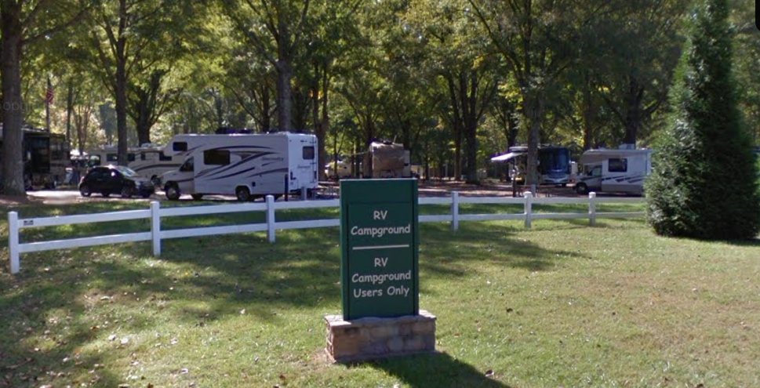
Tanglewood Park Campground Assessment & Expansion
The Tanglewood Park RV Campground operated 44 reservable sites for FY23. The Campground is open annually from April 1st to December 1st, generates approximately $350K in revenues annually. The 5yr average occupancy rate for weekdays is 65% and 86% for weekends. The 5yr overall occupancy rate is 79% for the 275+/- day operational season. A frequent customer comment is the lack of available sites to rent on the weekends.
Status – In planning
Total budget - $750,000
2023 PayGo

Slide 31
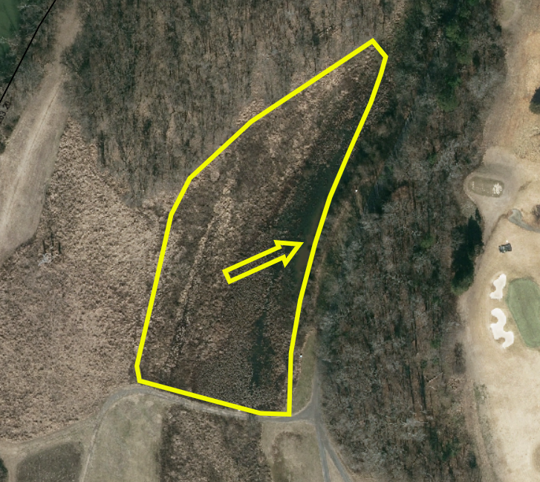
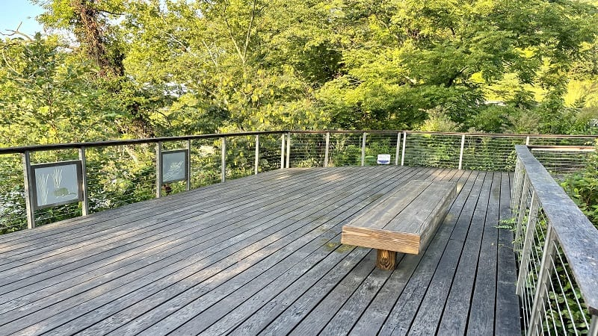
Tanglewood Park Wetlands Overlook
Local nature enthusiasts and the Forsyth Audubon Society advocated for handicap-accessible wetland viewing facilities on Tanglewood's Yadkin River Nature Trail. An accessible platform, along with accessible parking, will allow opportunities for a greater number of visitors to observe the Yadkin River Nature Trail and its diverse wildlife and plant species.
Status – In planning
Total budget - $175,000
2023 PayGo

Slide 32
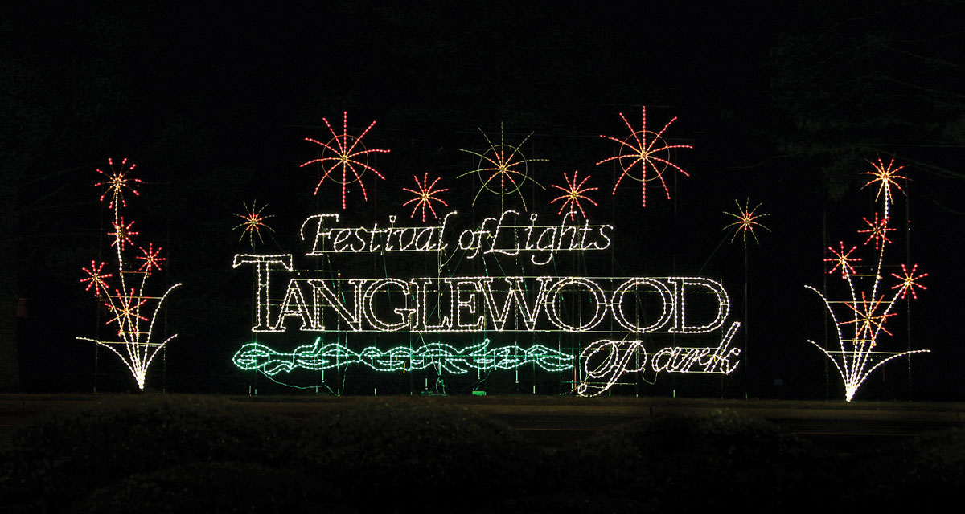
Tanglewood Park Festival Of Lights Display
The Tanglewood Festival of Lights is in its 32nd season. Over that period, manufacturing and technology costs of our displays have risen significantly. Customer surveys and input indicate that new interesting displays are desired for repeat visitors. Park staff are researching innovative displays that use more modern technology to enhance upcoming light shows. The Festival of Lights 5-year averages for vehicles is 54K vehicles with total revenues of just over $1M annually.
Status – In planning
Total budget - $250,000
2023 PayGo

Slide 33
Completed Capital Projects
2016 General Obligation Bond Projects
TWP Golf Course Renovations - ($3.25M) Completed 2019
Community Parks Playground Replacements - ($849K) Completed 2020
TWP Special Event Roadway Improvements - ($1.3M) Completed 2020
TWP Multi-Use Trail Additions - ($970K) Completed 2021
2018 & 2020 - 2/3rds Bond Projects
TWP Festival of Lights Displays - ($52K) Completed 2020
TWP Pasture Fencing Replacement - ($31K) Completed 2020
TWP Roadway Resurfacing - ($168K) Completed 2020

Slide 34
Completed Capital Projects
2018 & 2020 - 2/3rds Bond Projects (continued)
TWP Manor House Kitchen Upfits - ($32K) Completed 2021
TWP Activity & Lap Pool Replastering - ($202K) Completed 2021
TWP Red Barn Renovations - ($197K) Completed 2021
Festival of Lights Displays - ($34K) Completed 2021
Joanie Moser Playground Replacement - ($52K) Completed 2021
Mallard Lake Playground Resurface - ($84K) Completed 2022
TWP IT Network Hub Relocation - ($100K) Completed 2023
2021 & 2022 PayGo Projects
Joanie Moser Pickleball Complex - ($331K) Completed 2023

Slide 35
Forsyth County Project Planner - Parks

Slide 36
Airport Update

Slide 37
Forsyth County Project Planner Airport

Slide 38
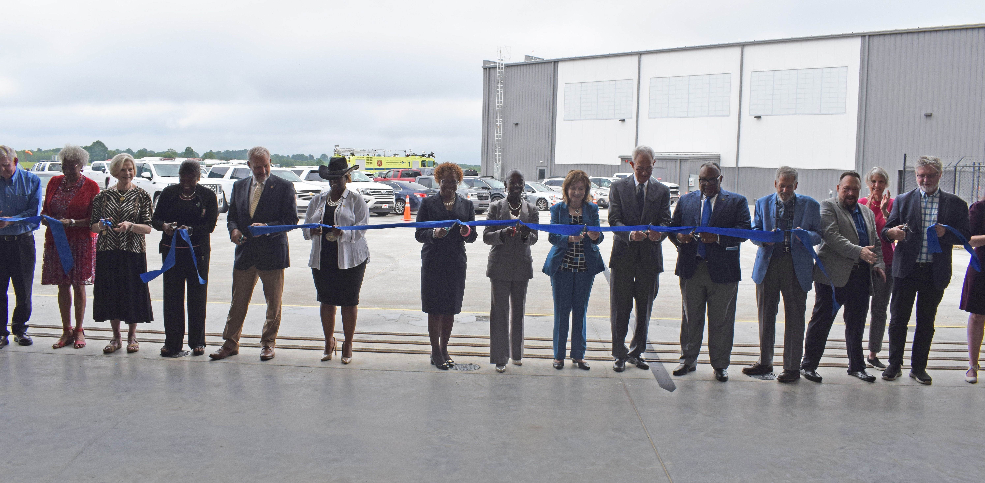
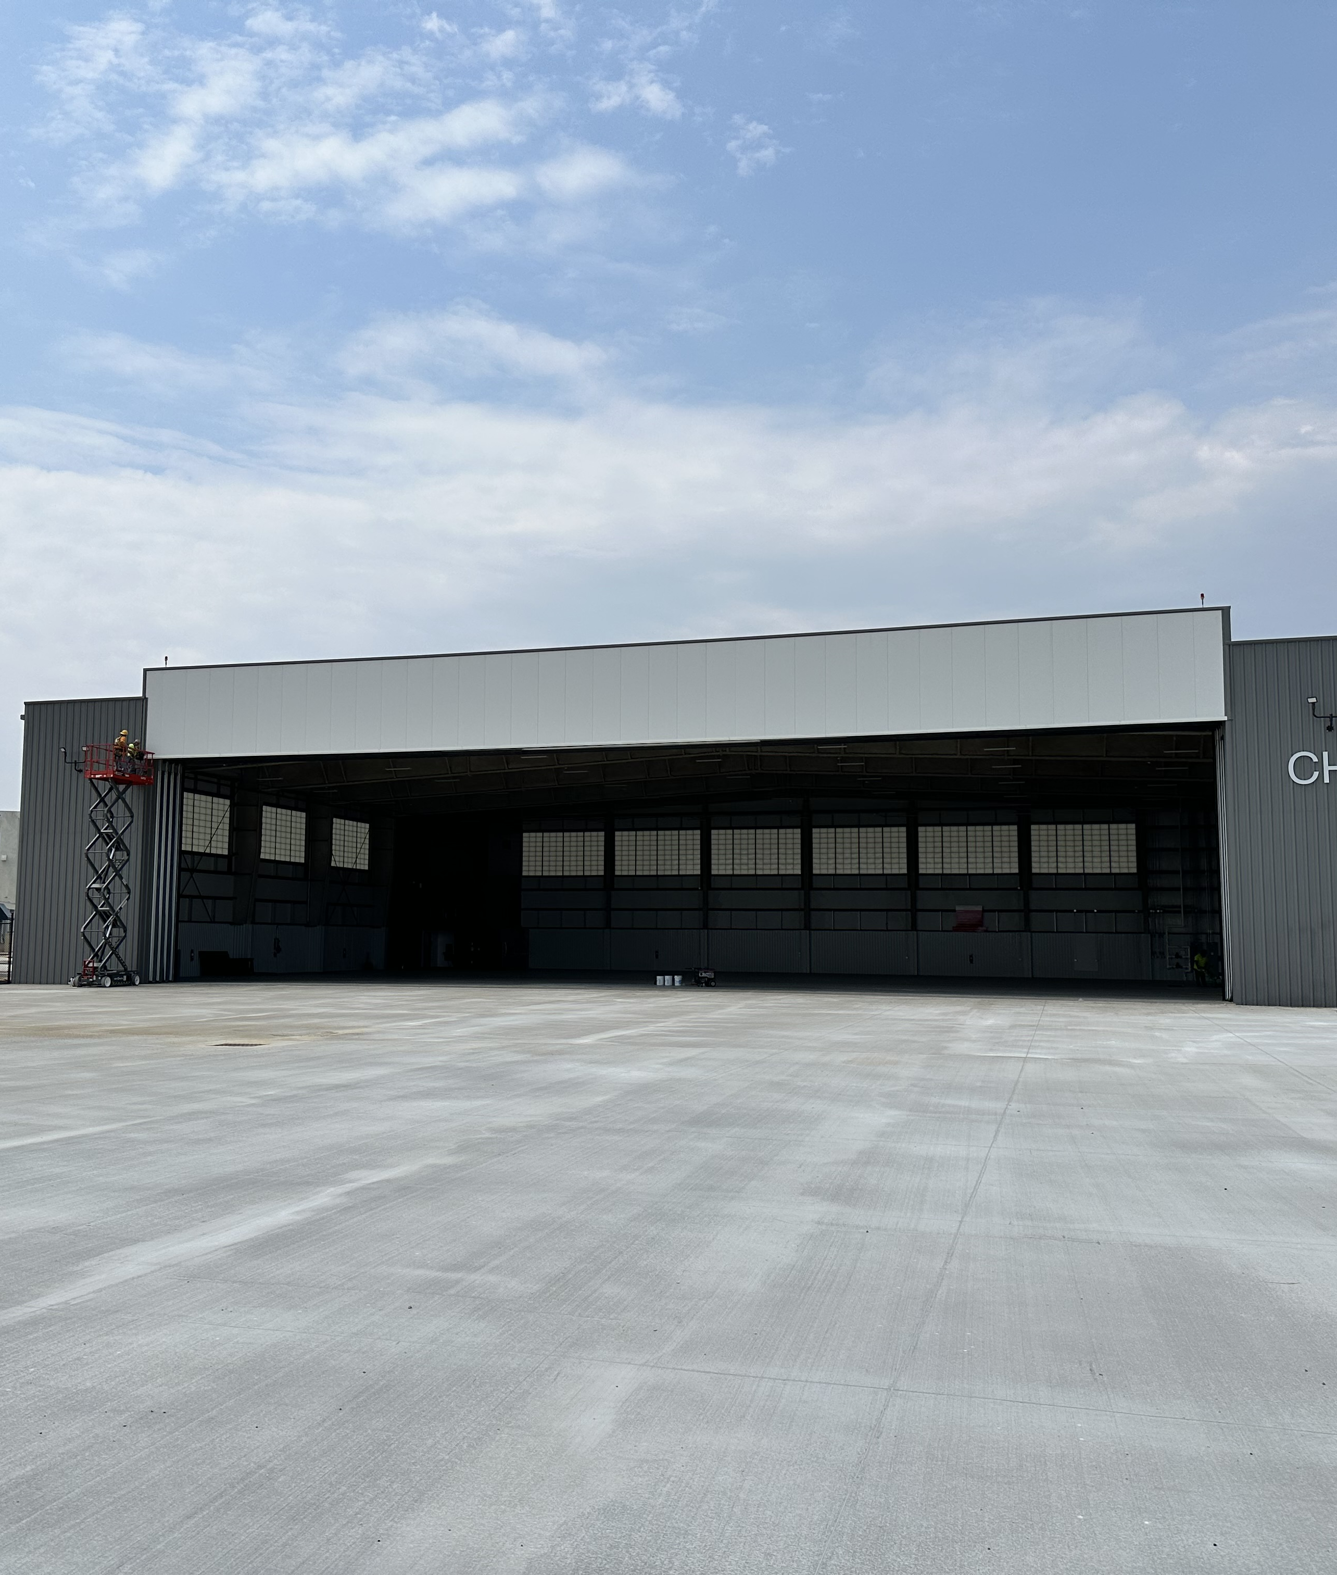
Corporate Hangar Development
Constructed two new corporate hangars to accommodate demand and to generate revenue at the Airport.
Status: Completed August 2023
Total Budget: $10,300,000
Limited Obligation Bonds $7.8M
State Capital Infrastructure Funds $2.5M

Slide 39
Runway 15-33 Rehabilitation
This project repaired a damaged stormwater pipe and resurfaced the asphalt on the longest runway at Smith Reynolds Airport (Runway 15-33 Length 6,655 feet x 150 feet wide). The runway was shut down for 28 days.
Status: Completed August 2022
Total Project $7,177,086
NCDOT Division of Aviation $6,459,377
Local Match $717,709

Slide 40
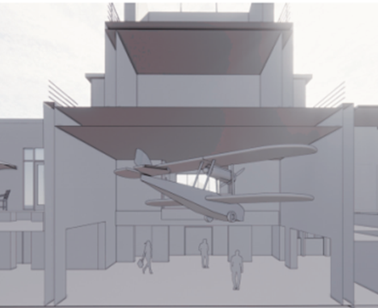
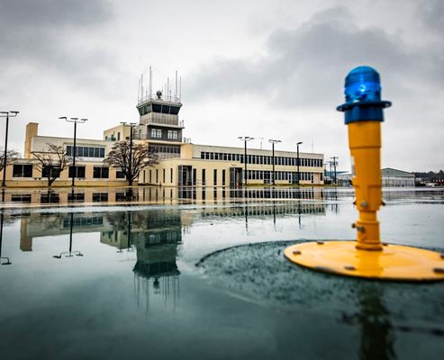
Terminal Building Renovations
The terminal building at Smith Reynolds Airport is an iconic building in Winston-Salem and has served as the front door of the community since it was originally built in 1941. This project will bring back the old style, but at the same time add modern attributes for travelers and tenants.
Status: Under Construction
Estimated Completion: 4th Quarter 2024
Total Budget $12,124,741
$7,124,741 Limited Obligation Funds
$5,000,000 State Capital Infrastructure Funds

Slide 41
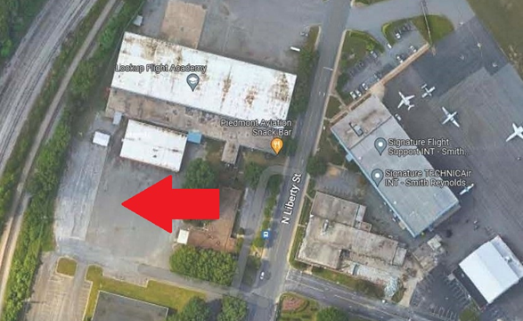
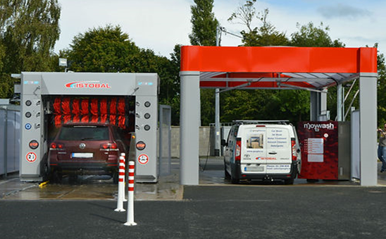
Rental Car and County Vehicle Fleet Wash Station
Construct new vehicle wash station that can accommodate rental car companies at the Airport and County fleet vehicles.
Status: In the process of executing contract for design.
Estimated Completion: 4th Quarter 2024
Total Budget $1,000,000
Local Airport Funds

Slide 42
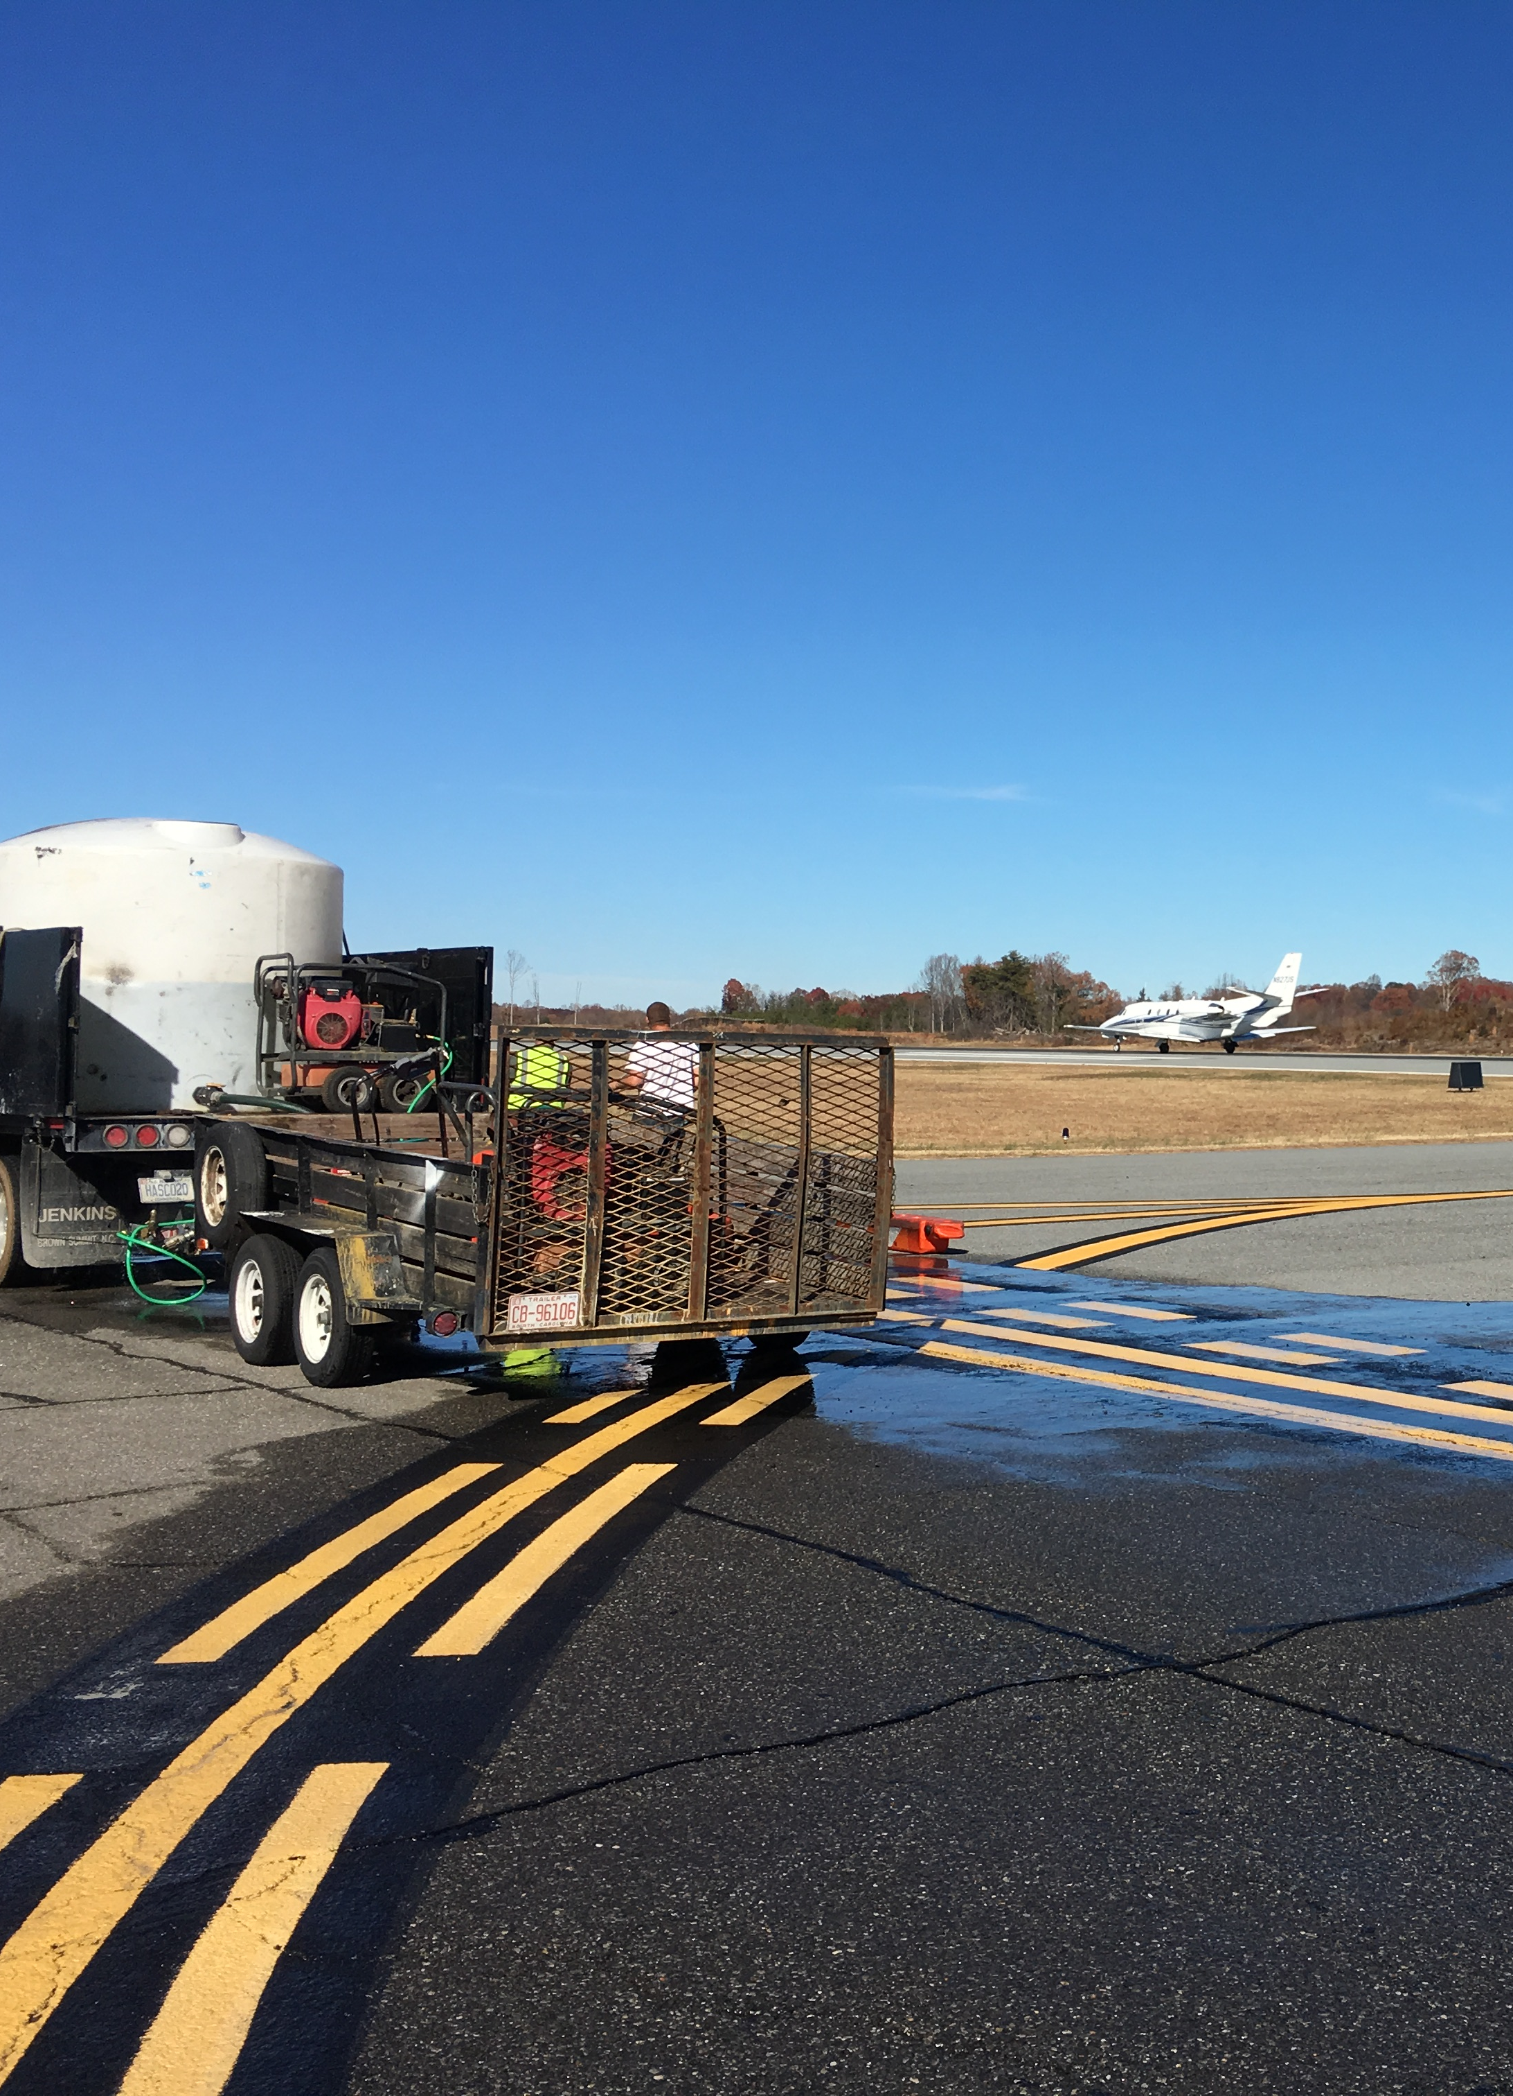
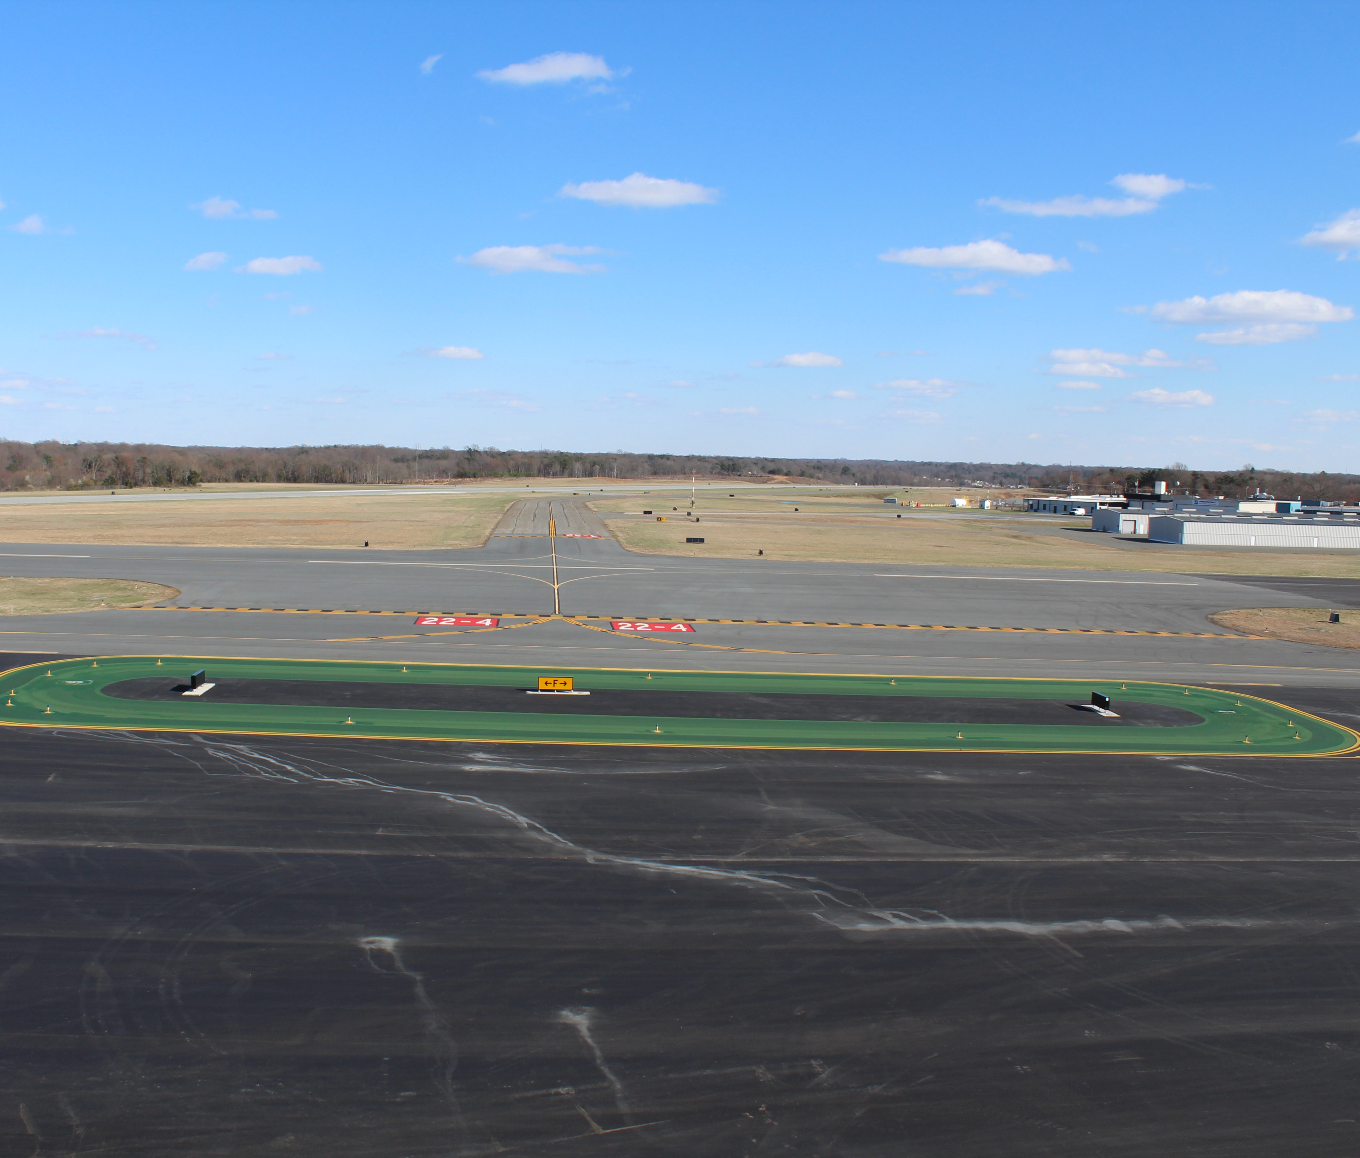
Taxiway Alpha
Taxiway Alpha runs parallel to Runway 15-33 and is in poor condition. This project will mill up the existing pavement and replace with new asphalt and markings.
Status: Design is at 90%
Estimated Completion 4th Quarter 2024.
Total Budget: $6,100,000
North Carolina Department of Transporation (NCDOT) State Aid $5,490,000
Local Airport Match $610,000

Slide 43
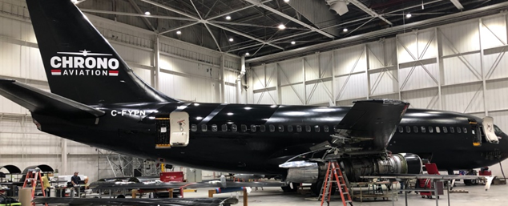
4001 N Liberty Street Hangar Improvements
In April 2021, the Economic Development Administration awarded the County a grant to make infrastructure improvements to the hangar facility North State Aviation is leasing from the County.
Status: Bid to the Public
Total Budget $6,068,015
EDA Funding $4,450,677
Local Match $1,617,338

Slide 44
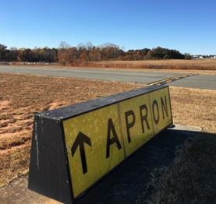
Airfield Lighting and Signage
The existing airfield has 525 lights and 114 lighted signs and this project will upgrade and replace the existing system.
Status: Under Design
Completion 3rd Quarter 2025
Total Budget $4,000,000
NCDOT Division of Aviation $3,600,000
Airport local match $400,000

Slide 45
Taxilane Lima and Ramp
This project will create a new taxilane north of Runway 4-22 and will allow for new hangar development. The taxilane and associated ramp will include improvements to Brushy Fork Creek which will slow down the volume of water after a storm event (dry pond).
Status: Finalizing Environmental Assessment (EA). Public Meetings
Completion 3rd Quarter 2025
Total Project Cost $14,000,000
Funded by State Transportation Investment at 100%

Slide 46
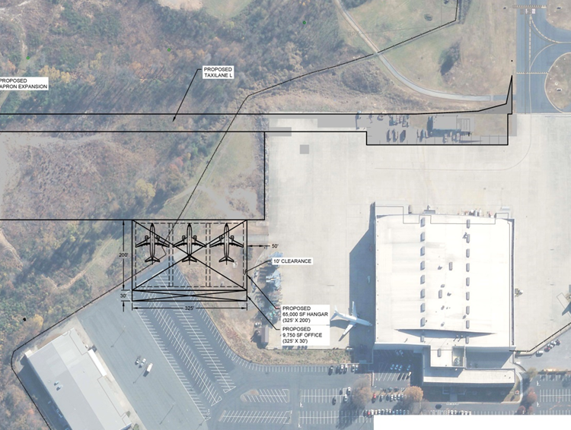
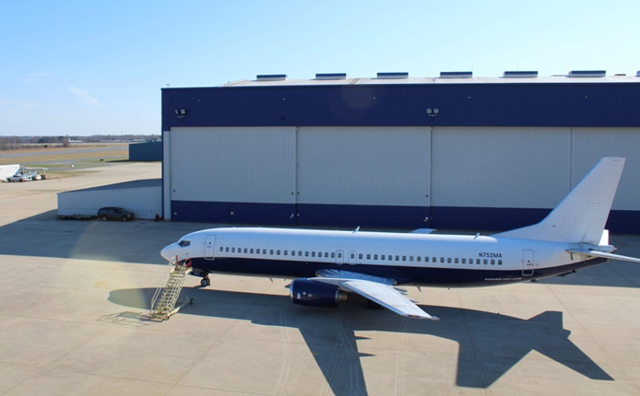
Maintenance Repair and Overhaul (MRO) Hangar
Construct new MRO Hangar to accommodate aircraft such as B737s and Airbus 320s. The proposed building would have three bays and would measure approximately 60,000 square feet and have offices and shop space.
Status: Selected Design/Build Firm and waiting for Environmental Assessment (EA) to be approved for adjacent taxilane and ramp.
Estimated Competition: 3rd Quarter 2025
Total Budget $14,900,000
State Capital Infrastructure Funds (SCIF) 100%

Slide 47
Other Capital Projects
Piedmont Propulsion "Pit" - Public Bid
Brushy Fork Creek Mitigation – Design Firm Selected
NC Land & Water Grant ($300k)
County Grant Match ($90k)
City (< 300K)
3820 Hangar Doors – Under Design
Engineering Material Arresting System (EMAS) Restoration – Under consideration for funding STI Prioritization 7 NCDOT
Landfill Redevelopment – Reviewing Proposals

Slide 48
Forsyth County Project Planner Airport

Slide 49
Economic Development Update

Slide 50
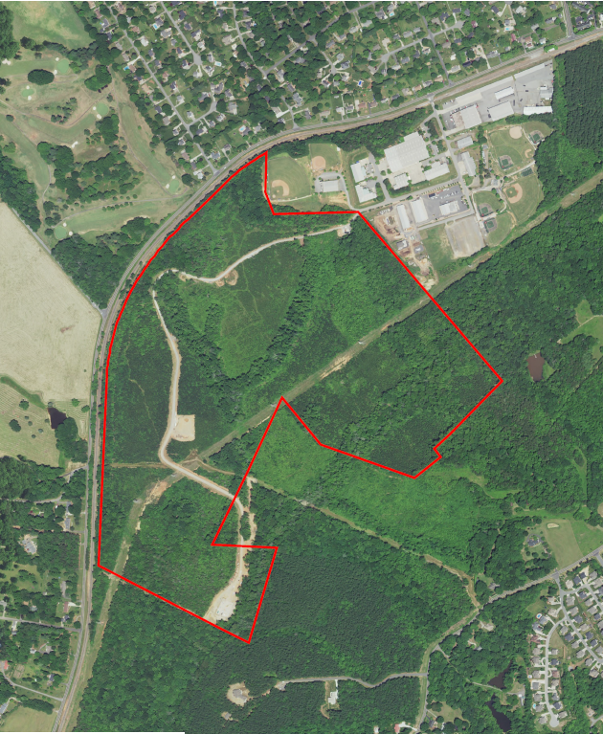
Tanglewood Business Park
County owned parcel south of Tanglewood Park
Identified highest and best use as Business Park
Adjacent to current industrial use
Potential for rail access
Completed feasibility study and concept plan in 2016

Slide 51
Tanglewood Business Park
Goal is to create an employment center compatible with surrounding area
Industrial Park
Residential Communities
Tanglewood Park
Currently zoned both residential and general industrial
County developed and recorded Protective Covenants further limiting uses on the property
Greater Winston-Salem, Inc marketing property
Restricted to clean, high-tech manufacturing, research and office

Slide 52
TBP Development Activity to Date
Conducted pre-development due diligence
Phase I
Wetlands
Geo Tech
Surveys
County partnered with City/County Utilities to construct lift station on property
Would serve TBP and surrounding sub-basin
Constructed a stub entrance to property from Idols Rd, crossing the rail tracks
Ties into temporary construction road running from Topsider Drive to lift station

Slide 53
TBP Next Steps
Received $2.4M for sewer and water infrastructure from State
Current contract with Highfill Engineering to determine location, size, and cost estimate for sewer outfall line
Move forward with construction to serve park and surrounding sub-basin development
Determine strategy for development
Finalize layout or remain open?
Extend utilities internally?
Clear and grade sites?
Funds for development
Approximately $360k remaining from previous County appropriations
Applying for grant from GoldenLEAF to fund site development costs

Slide 54
Employment Center Identification
Staff presented constraints on future employment center development at Winter Work Session
Access to sewer largest constraint
State Budget contains $20M for sewer development in Southeast Forsyth
CED, Planning, and Utilities analyzing areas with highest potential
5 areas identified in Southeast Forsyth Area Plan Update

Slide 55
Potential Employment Centers

Slide 56
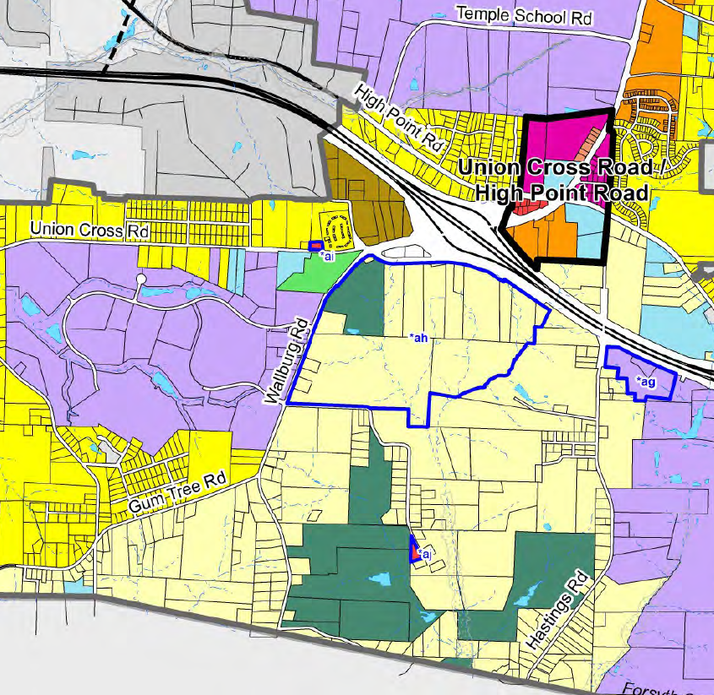
Wallburg Road Area
Approximately 250 acres
Adjacent to existing business parks
Union Cross Business Park
Ardagh Distribution facility
Proximate to Hwy 311/I-74
Currently zoned large lot residential/agricultural
Preliminary engineering completed for lift station

Slide 57
Employment Center ID Next Steps
Accept funds from State
Staff continue to analyze highest potential among sites
Explore possibility of land acquisition
Bring recommendations to Board of Commissioners
Partnerships with City/County Utilities Commission for Design, Engineering, and Development

Slide 58
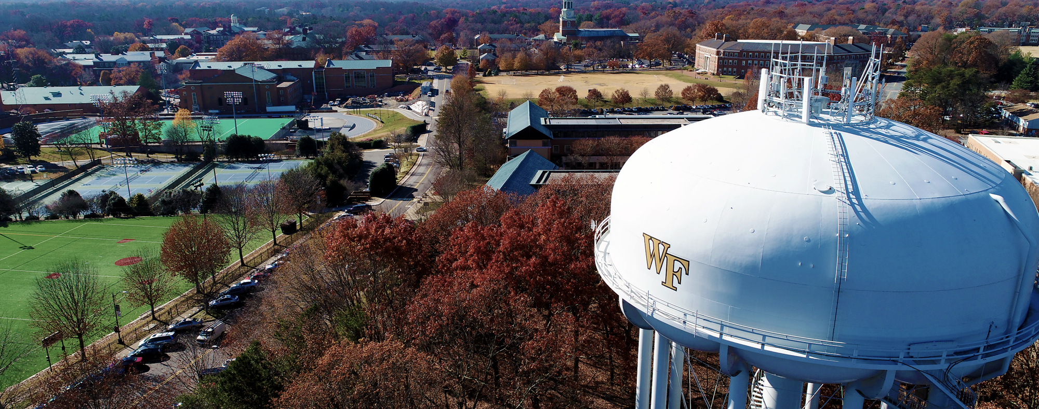
Winston-Salem/Forsyth County Utilities

Slide 59
Active Capital Projects
Number of projects: 48
Design: 26
Bidding: 5
Construction: 17
Spent during FY23: $79M
Estimated spending for FY24: $97M

Slide 60
WSFC Utilities Project Planner

Slide 61
Highway 65 Water Line Extension

Slide 62
Highway 65 Water Line Extension
Forsyth County applied for a Community Development Block Grant to extend water along Highway 65.
WSFC Utilities agreed to administer the project with the understanding the waterline would be conveyed to the City of Winston-Salem for ownership and maintenance once complete.
In lieu of CDBG, the City of Winston-Salem received $3.1 million to fund this project from North Carolina’s American Rescue Plan Act funds (federal funding which necessitates additional project requirements).
Hazen and Sawyer was selected for design, bidding, and construction administration services.

Slide 63
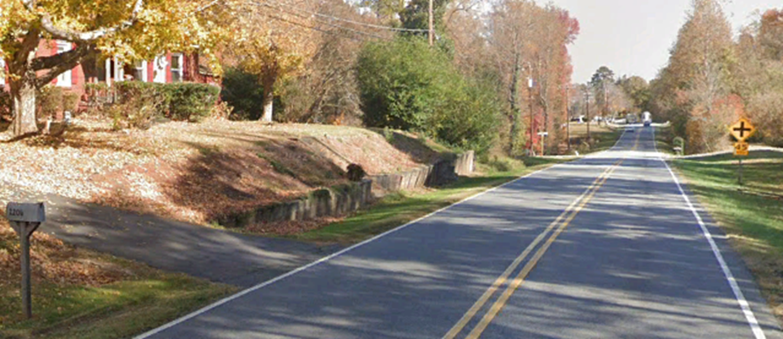
Highway 65 Water Line Extension
Survey and geotechnical work have been completed
90% construction drawings and specifications are due November 2023
Project critical path depends on permitting (one stream crossing)
Advertise project in April 2024
Issue Notice to Proceed to Contractor August 2024
Construction complete Spring/Summer 2025

Slide 64
Tanglewood Force Main Relocation
The existing sanitary sewer force main leaving the Tanglewood Lift Station has deteriorated and needs to be replaced.
Five alternative routes were evaluated based on cost, total length, risk, environmental impacts, and property owner impacts.
Property owners were notified in June that surveying would begin
Field survey is complete.
90% construction drawings and specifications are due November 2023.
Easement acquisition spring 2024.
Advertise construction project for bids summer 2024.
Project funded through utility fund (sewer rates)

Slide 65
Tanglewood Force Main Relocation

Slide 66
Advanced Meter Upgrade Program
Also called Water Savvy
Installation of over 136,000 new smart water meters as well as the installation of 28 base station towers
Project will improve data and customer experience, customers will be able to monitor their usage, pay their bills and set up alerts for leaks through a customer portal
Base station tower installation was completed last year and over 39,000 meters have been changed to date
Project funded through utility fund (water rates)

Slide 67
Advanced Meter Upgrade Program

Slide 68
WSFC Utilities Project Planner

Slide 70
Questions?

