Slide 1

2025-2026 Budget Request
May 13, 2025

Slide 2

Table of
Contents
Overview
District Mission and Vision . . . . . . . . . . . . . . . . . . . . 4
Strategic Plan Goals . . . . . . . . . . . . . . . . . . . . . . . . 5
Investment Priorities. . . . . . . . . . . . . . . . . . . . . . . . . 6
Superintendent’s Budget Message . . . . . . . . . . . . . 7-10
Student Data
Student Enrollment . . . . . . . . . . . . . . . . . . . . . . . . . . 12
Student Population . . . . . . . . . . . . . . . . . . . . . . . . . . 13
Exceptional Education . . . . . . . . . . . . . . . . . . . . . . . 14
Multilingual Learners . . . . . . . . . . . . . . . . . . . . . . . . . 15
Economically Disadvantaged . . . . . .. . . . . . . . . . . . . 16
Student Achievement Data . . . . . . . . . . . . . . . . . . . . 17-26
Staff Data
Positions by Funding Sources . . . . . . . . . . . . . . . . . . 28
Teacher Experience . . . . . . . . . . . . . . . . . . . . . . . . . . 29
2025 Local Salary Supplements . . . . . . . . . . . . . . . . . 30
Funding Uses and Sources
FY 2024 Expense by Fund. . . . . . . . . . . . . . . . . . . . . 31-38
FY 2024 Local Fund Expenses . . . . . . . . . . . . . . . . . 39-40
FY 2024 Restricted Grant Revenue Fund . . . . . . . . . 41
FY2026 Budget Request
FY 2026 Budget Process. . . . . . . . . . . . . . . . . . . . . . . 43
FY 2026 Investment Priority Alignment . . . . . . . . . . . . 44-46
Position Management 47-49
Budget Savings Plan 50
FY 2026 Local Non-Personnel Request . . . . . . . . . . . 51
Proposed Funding Formula
FY 2026 Proposed County Formula . . . . . . . . . . . . . . 52-53
Proposed County Appropriation
2025-2026 Local Budget Request . . . . . . . . . . . . . . . 54-55
Recommended Next Steps 57
Appendices
Expense Breakout by Funds . . . . . . . . . . . . . . . . . . . 58-65

Slide 3

Overview

Slide 4
District Mission and Vision
Mission
Winston-Salem/Forsyth County Schools will engage all students in high-quality, relevant learning experiences so they graduate with interpersonal, academic and workforce skills to compete globally and contribute to society.
Vision
Winston-Salem/Forsyth County Schools will be the best place to learn and work through excellence, collaboration and inclusiveness.
1

Slide 5
Current Strategic Plan Goals
Goal 1: WS/FCS will raise student achievement, close achievement gaps and enable all students to take ownership of their learning.
Goal 2: WS/FCS will ensure equal and equitable access to quality instruction and strive to eliminate barriers to rigorous and diverse opportunities.WS/FCS will provide quality instructional facilities and learning environments for all students.
Goal 3: WS/FCS will build and strengthen partnerships and communication with families, local businesses, educational organizations, community agencies and advocacy groups in order to engage families and community stakeholders in the entire educational process for all students.
Goal 4: WS/FCS will recruit and retain a highly effective and diverse workforce that supports district goals to ensure excellence for all.
Goal 5: WS/FCS will foster an inclusive climate that values the safety and well-being of all students, faculty and staff and foster an environment that creates a sense of belonging.
2

Slide 6
Investment Priorities
Behavioral & Mental
Health
Well-
Rounded Education
Core
Instruction
Employee Retention
Efficient
Operations
3

Slide 7

Superintendent’s Budget Message-ALL Students Future Ready
Funding for the 2025-2026 school year will allow WS/FCS to continue striving toward excellence in advancing student outcomes and creating school environments where all students thrive. Plans will continue to focus on student achievement, access and opportunity to high quality instruction and enriched learning opportunities, recruitment, and retention of strong talent, strengthening family and community engagement, and fostering a safe and inclusive climate that prepares students to demonstrate the durable skills in our portrait of a graduate. Funds provided by local, state, and federal sources will support efforts designed to ensure that all students in WS/FCS are future ready!
Our 2025-2026 budget request continues to support our strategic plan goals while addressing the evolving needs of our students and staff. The budget request is organized into five investment priorities aligned to our strategic plan goals. These include core instruction, well rounded education, behavioral and mental health, employee retention, and efficient operations. All requested funds will support efforts in these areas.
4

Slide 8


Investment Priority 1 – Core Instruction
This priority ensures that every student will experience deeper learning in their classrooms
every single day through access to quality lessons, educational resources and aligned
assessments. It will allow us to provide high-quality professional development, coaching,
and mentoring for teachers, leaders, and classified staff. It will allow us to provide resources,
tools, and interventions to better support students served through Exceptional Education
and Multi Language Learner services and will allow us to continue providing
technology and other resources to support personalized learning. It will allow us to continue
strengthening magnet programming and pathways, CTE pathways, and access to real world
experiences. Finally, it will allow us to continue to place an emphasis on pre-kindergarten and
early literacy as critical foundations for learning.
Investment Priority 2 – Well Rounded Education
This priority ensures that students have greater access to extra curriculars to include the arts, athletics, robotics, eSports, STEM, academic, and other clubs. It will allow us to provide more resources to support these activities. It will also allow us to support field trips andtrips and other hands on- trips and experiential learning opportunities that take place both in school and away from school. These investments will help us connect every student to something of interest outside of their academic work.
5

Slide 9


Investment Priority 3 – Behavioral and Mental Health
This priority ensures that every student feels a sense of belonging as they enter our schools every day. This priority addresses the social, emotional, mental, and physical well-being of our students, which are precursors to learning. Funds will allow us to provide increased mental health support, social emotional learning and restorative and trauma informed practices resources, substance use support, attendance incentives and resources, and outreach to families.
Investment Priority 4 – Employee Retention
This priority ensures that we invest in our employees through compensation, retention, and wellness efforts to include market rate compensation for classified employees, ongoing professional development, career ladder opportunities, future teacher and leader programs and partnerships, and employee recognition programs. It will also allow us to continue growing teacher cadet programs, residencies, and other workforce preparation programs.
6

Slide 10


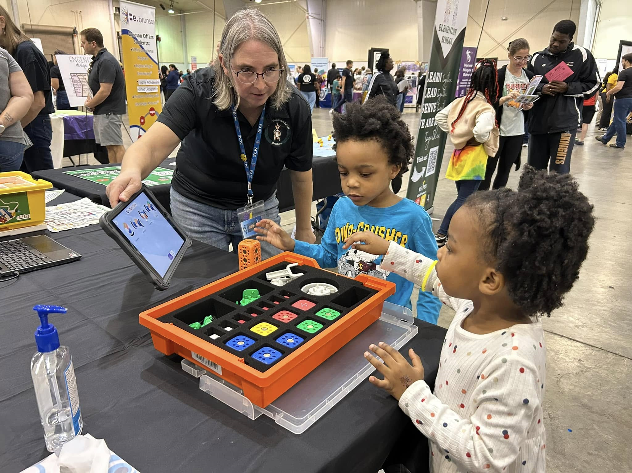
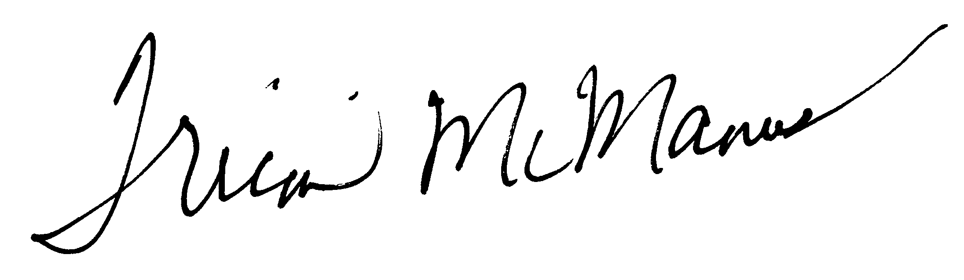
Investment Priority 5 – Efficient Operations
This priority ensures our learning facilities, transportation services, and all operations of the school district are up to par. These fund requests allow us to keep campuses clean, safe, and optimal for student learning.
I am confident that by investing our funds on what is most important and what research shows to yield the highest impact; we will achieve success for every one of our learners. An investment in our students is an investment in the future of our community.
Sincerely,
Tricia McManus
7

Slide 11
Student Data

Slide 12
Student Enrollment
Note: Enrollment figures provided by the NC Department of Public Instruction, Second Month of School for 2024-2025. Figures do not include Pre-K Students. The Pre-K program is funded under a separate state program. Currently the District uses local funds to cover any Pre-K operating expenses above the State provided funds.
8

Slide 13
Student Population
2024-2025 WS/FCS Student Population (Count as of December 2024)
American Indian 66. Asian 1,337. Hispanic 15,532. Black 14,448. White 15,913. Pacific Island 66. Two or More Races 2,869. Total 50,231.
9

Slide 14
Students Being Served Through
Exceptional Education Services
Note: 2024-25 number is as of December 2024.
10

Slide 15
Students Being Served Through
Multilingual Learner Services
11

Slide 16
Economically Disadvantaged Percentages
Note: Percentages are defined by students deemed eligible for national school free/reduced lunch program. The 2024-25 percentage is as of March 31st and does not include Pre-K Students.
12

Slide 17
WS/FCS EOG & EOC GRADE LEVEL PROFICIENCY
Subject | 2019 | 2021 | 2022 | 2023 | 2024
3rd Grade Reading | 51.7 | 39.3 | 40.2 | 44.9 | 46.4
Reading 3-8 | 54.9 | 38.1 | 39.7 | 44.5 | 43.9
Math 3-8 | 54.4 | 30.9 | 40.7 | 46.8 | 48.4
Science 5 & 8 | 72.7 | 54 | 59.9 | 61.8 | 62.1
English II | 56 | 56.5 | 54.2 | 53.9 | 54
Math I | 36.1 | 16.4 | 23.6 | 23.2 | 22.5
Math III | 45.5 | 43.4 | 47.9 | 52.1 | 54.1
Biology | 57.4 | 42.9 | 47.8 | 50.6 | 50.6
13

Slide 18


High School Graduation Rates
87.7
86.2
85.5
85.4
85.4
2019
2021
2022
2023
2024

Slide 19
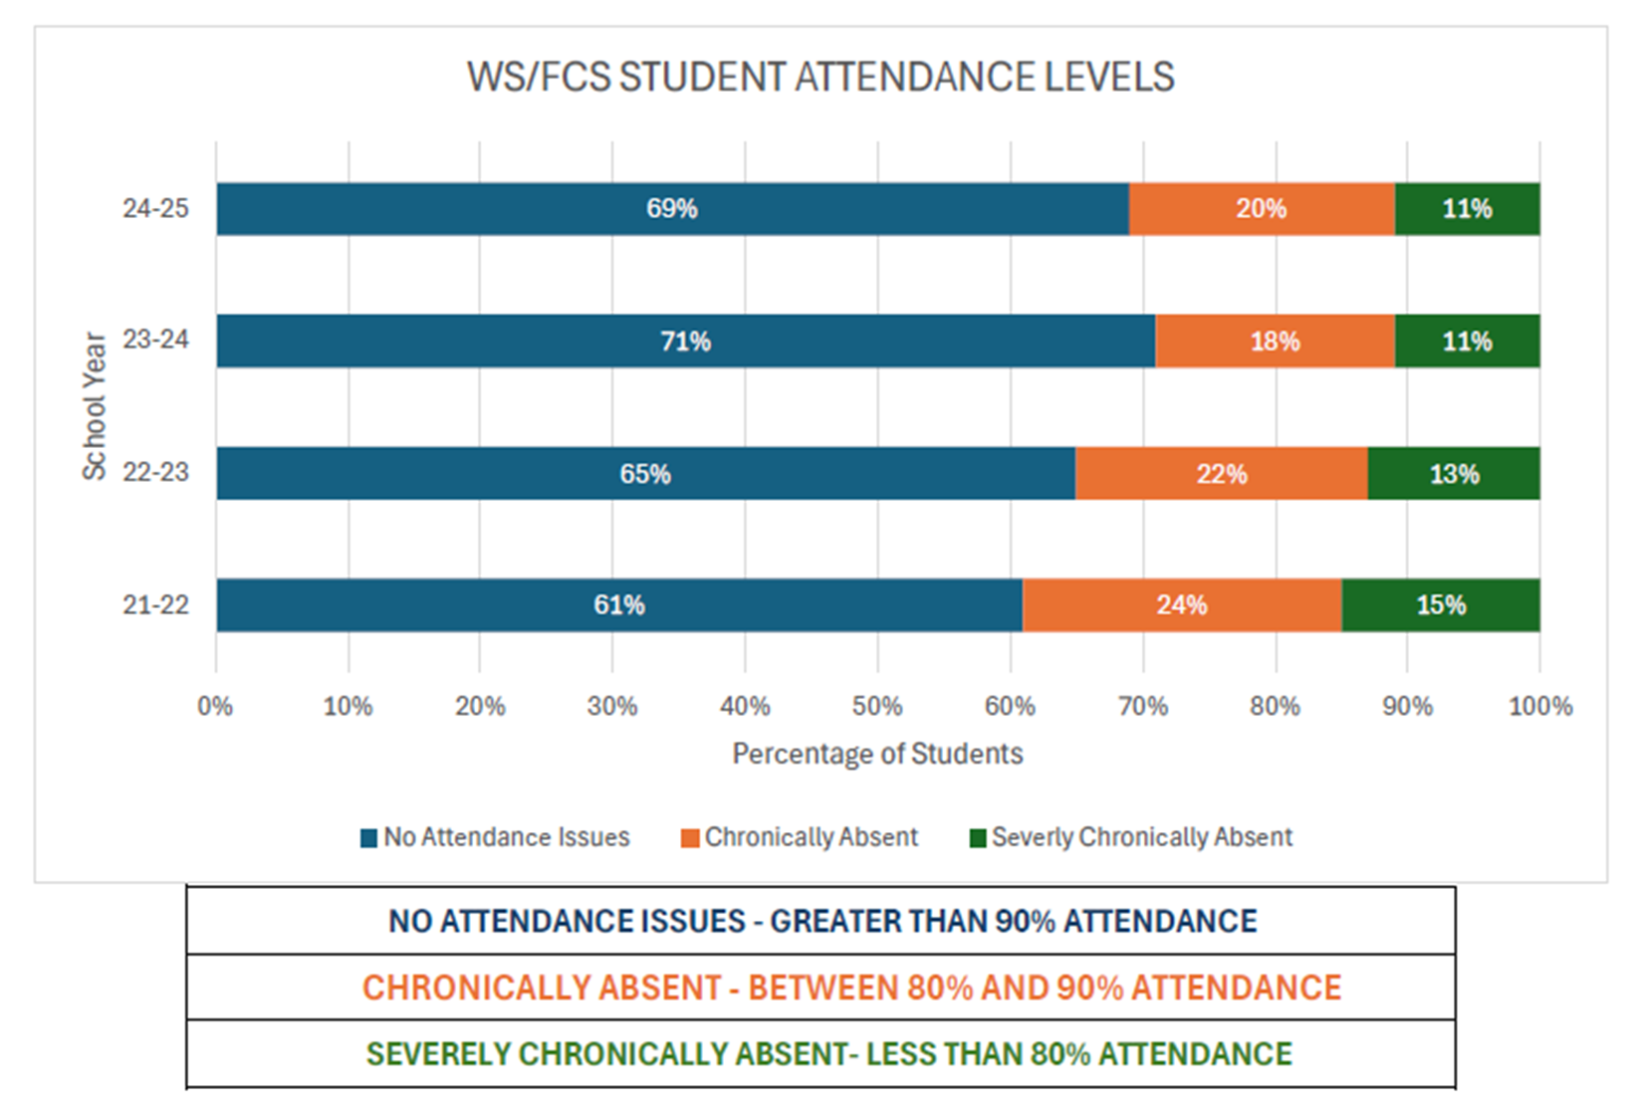
2024-2025 School Year Attendance
15

Slide 20
WS/FCS Pandemic Recovery compared to Pandemic Recovery Across NC
The following slides demonstrate that in grades 3-5 ELA and Math:
  WS/FCS has exceeded district pre-pandemic trends
  WS/FCs has exceeded the state of NC in pandemic recovery
16

Slide 21
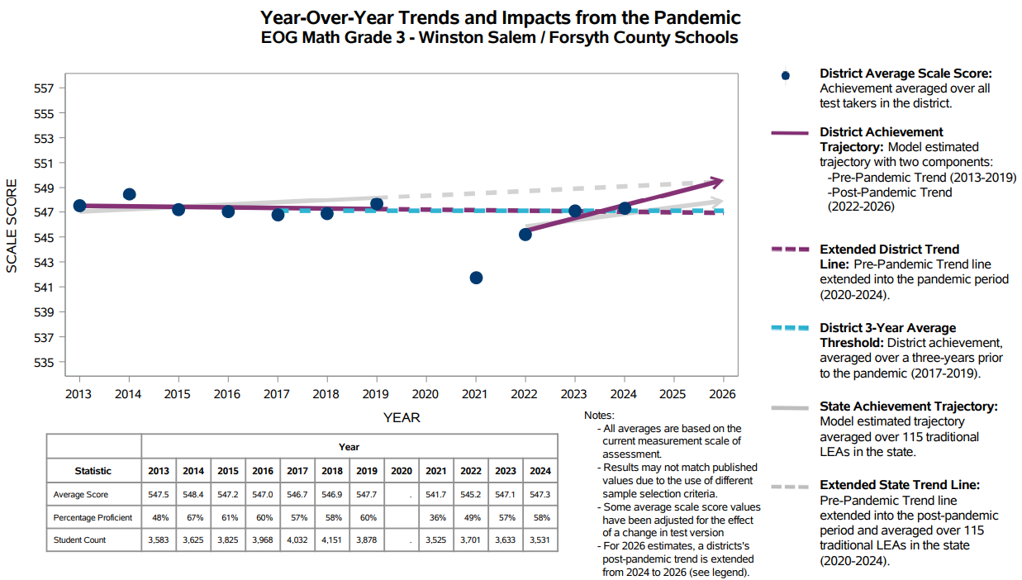
17

Slide 22
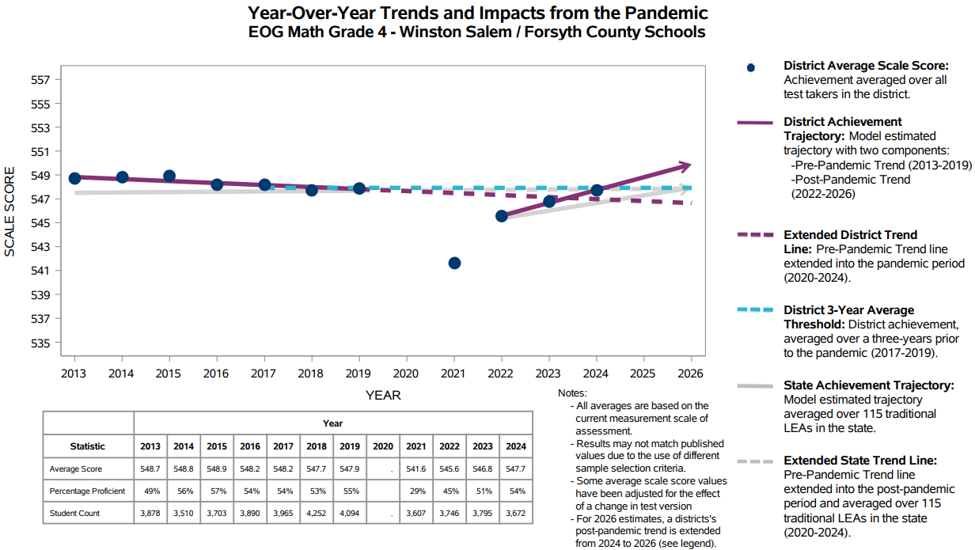
18

Slide 23

19

Slide 24
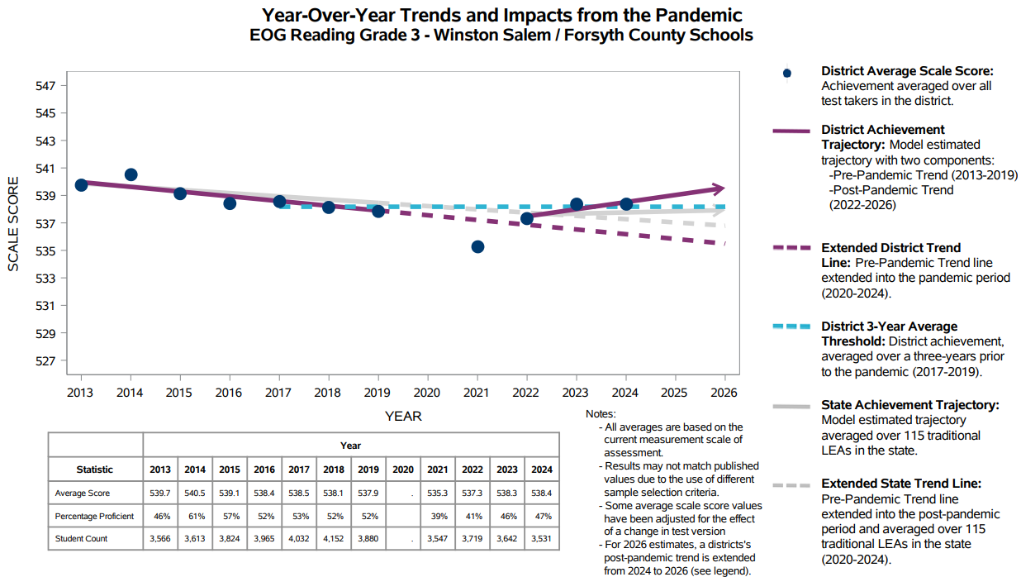
20

Slide 25
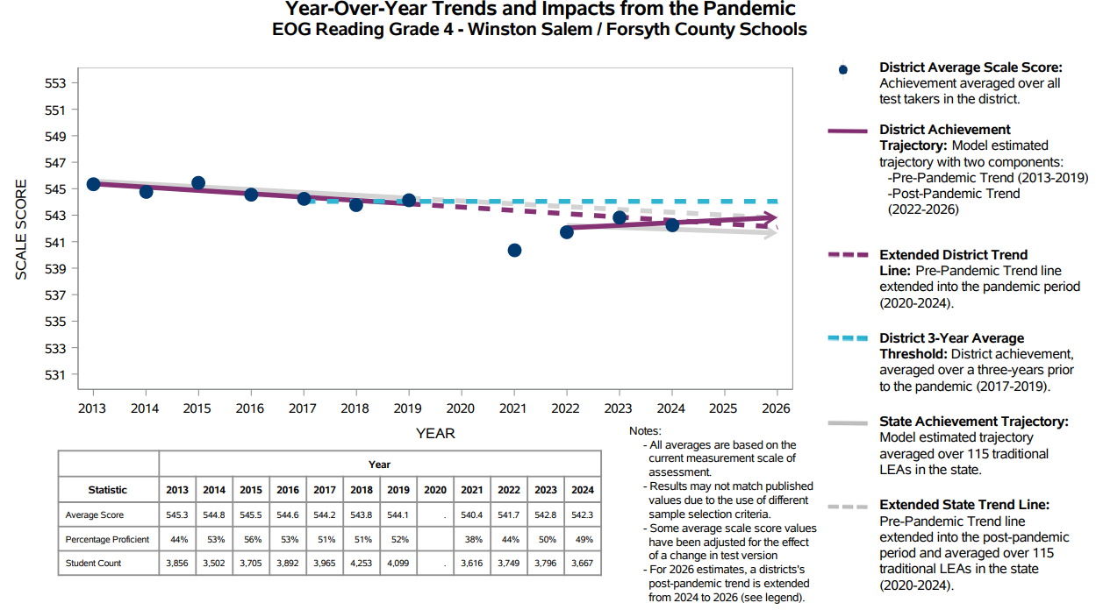
21

Slide 26

22

Slide 27
Staff Data

Slide 28

Position Counts by Funding Source, Without Vacancies
Position Totals by Year
2013-14 6,272
2015-16 6,317
2017-18 6,538
2019-20 6,501
2021-22 6,350
2022-23 6,763
2023-24 6,710
2024-25 6,797
Note: 2024-2025 projections are based on March 2025 numbers. Numbers are higher than 2023-2024 because there are less vacancies.
23

Slide 29
2024-2025 Teacher Experience by Years
Note: Of the 4,329 teachers; 3,146 have 6 to 30 years of experience. This impacts the District supplement cost.
25

Slide 30
2025 Local Salary Supplements
Winston-Salem Forsyth County Schools Rank #9
DPI Table 20 Selected Statistics
26

Slide 31
Funding Sources and Uses

Slide 32

FY 2024 Expense by Fund
State Public School Fund | $381,795,004 | 50%
Local Current Expense Fund | $180,136,329 | 23%
Federal Grant Fund | $49,677,613 | 6%
ESSER Fund | $51,562,337 | 7%
Capital Outlay Fund | $49,943,943 | 7%
Child Nutrition Fund | $36,297,391 | 5%
Childcare/Daycare Fund | $563,902 | 0%
Other Restricted Fund | $17,661,963 | 2%
Total Expense | $767,638,482 | 100%

Slide 33
Expense Descriptions
Salaries Amounts paid to persons who are employed by the local school administrative unit in a permanent, temporary, or part-time position or one who substitutes for those in permanent positions.
Employer Provided Benefits Amounts paid by the local school administrative unit on behalf of employees, in addition to the regular salary. Such payments are fringe benefit payments, and while not paid directly to employees, nevertheless is part of the total compensation cost of the employee.
Purchased Services Amounts paid for personal services rendered by personnel who are not on the payroll of the local school administrative unit and other services that the local school administrative unit may purchase.
Supplies and Materials A supply item is any article or material which meets any one or more of the following conditions: 1) it is consumed in use; 2) it loses its original shape or appearance with use; 3) it is expendable, that is, if the article is damaged or some of its parts are lost or worn out, it is usually more feasible to replace it with an entirely new unit rather than repair it (which is not true of equipment); 4) it is an inexpensive item, having characteristics of equipment, whose small unit cost makes it inadvisable to capitalize the item; and 5) it loses its identity through incorporation into a different or more complex unit or substance.
Capital Outlay Expenditures for the acquisition of fixed assets or additions to fixed assets. They are expenditures for land or existing buildings, improvement of grounds, construction of buildings, additions to buildings, remodeling of buildings, initial equipment, additional equipment, and replacement of equipment.
Transfers Amounts paid from one fund to another fund or to another entity, as permitted by law, which do not represent a purchase of a good or service and consequently for which the local school administrative unit received no return.
28

Slide 34
FY 2024 Expenses for Major Funding Sources
State, Local & Federal Funds

Slide 35
FY 2024 Expenses for Major Funding Sources
State, Local & Federal Funds

Slide 36
FY 2024 State Public School Fund Expenses

Slide 37
FY 2024 Federal Grant Fund Expenses (excluding ESSER)

Slide 38
FY 2024 Local Current Fund Expenses

Slide 41
FY 2025 Restricted Grant Revenue Fund
124 Total District Grants $17,598.800.50
107 out of 124 are Ongoing Grants $16,260,820.58
17 out of 124 are New FY 2024 Grants $1,337,979.92
Note: The district continues to seek new funding through competitive state and federal grants.
36

Slide 42
FY 2026 Budget Request

Slide 43
FY 2026 Budget Process
The overall objective of the FY 2026 budget process is to ensure that the District’s financial resources continue to be directed toward students and staff based on our district investment priorities and that we present a balanced budget to the Board and County.
Part of ensuring a balanced budget was to make estimates based on being fully staffed and mapping out clear positions controls so that every position (if fully staffed) is directly tied to a funding source.
Starting with a funding formula supported the development of the proposed budget.
37

Slide 44
2025-2026 Planning Budget Amounts
 | Local | State | Federal | TOTAL
Amount | 180,391,341 | 385,000,000 | 50,000,000 | 615,391,341
Winston-Salem Forsyth County Schools Investment Priorities
Core Instruction
Well-Rounded Education
Behavioral & Mental Health
Employee Recruitment & Retention
Efficient Operations
38

Slide 45
Examples of Investment Priorities for Both Personnel and Non-Personnel Costs
Priority | Personnel | Non-Personnel
Core Instruction | Teachers Central Office Supports Teaching and Learning Staff Substitute Teachers Curriculum development stipends Professional Development | Instructional supplies & materials Instructional diagnostic & supplemental software Student & staff devices
Well-Rounded Education | Encore Teachers Bilingual Parent Assistants Contracted Interpretation/Translation Services High Dosage Tutoring | Encore supplies & materials Field trips Graduation costs Magnet school supplies & materials Athletic supplies & materials
Behavioral & Mental Health | Social Workers Nurses Psychologists Student Services Staff | Counseling services Student mentoring/mediation programs Contracted services for students with 504 plans EpiPens for emergency use
39

Slide 46
Examples of Investment Priorities for Both Personnel and Non-Personnel Costs
Priority | Personnel | Non-Personnel
Employee Recruitment & Retention | Teacher Supplements Teacher Leadership Advance Teacher Support Teacher Residency International Teacher Support (green-cards, VISAs) Market Study Classified Compensation Local Longevity Classified | Staff professional development New teacher supports Teacher Academy expenses Teacher Residency expenses Reduction in Teacher Residency Fees for Tier 2 & 3 Schools
Efficient Operations | Data Managers School Financial Managers Bus Drivers Skilled Trade Workers Maintenance Workers Technicians Central Office Maintenance and Custodial Staff | Utilities (Electricity, Gas, Water/Sewer) SRO Contract Custodial services, supplies & materials, & repairs Facilities expenses & repairs Plumbing expenses & repairs General maintenance expenses & repairs Painting expenses & repairs Grounds expenses & repairs Electrical expenses & repairs HVAC expenses & repairs Transportation expenses & repairs Charter Schools
40

Slide 47
25-26 Projected Position Management
Position Type | State | Federal | Other State PRC or Local | Total positions
Licensed Instructional Staff* | 3,259.5 | 35.75 | 350.72 | 3,645.97
Instructional Support Staff* | 247 | 33 | 108.5 | 388.5
Classified Instructional Staff* | 360 | 258 | 271.5 | 889.5
School Based Administration | 124 |  | 101.58 | 225.58
Central Office Administration (Program Mgr to Superintendent) | 14.7 | 14.25 | 100.05 | 129
Non-Instructional Staff | 280 | 2.25 | 487.79 | 770.04
Trade Skills |  |  | 148 | 148
School Based Purchased Federal Positions |  | 251.16 |  | 251.16
Bus Drivers* | 275 |  |  | 275
Total | 4560.2 | 561.41 | 1568.14 | 6,690.02
* Denotes positions listed in 10 month of employment positions

Slide 48
2025-2026 Projected Cost to Local or Other State PRCs
Position Type | Other State PRC or Local | Projected Total Cost
Licensed Instructional Staff* | 350.72 | $24,039,167
Instructional Support Staff* | 108.5 | $9,240,229
Classified Instructional Staff* | 271.5 | $13,575,000
School Based Administration (11 MOE) | 101.58 | $9,936,227
Central Office Administration (Program Mgr to Superintendent) | 100.05 | $13,806,900
Non-Instructional Staff | 487.79 | $29,267,400
Trade Skills | 148 | $8,732,000
Total Position / Cost | 1568.14 | $108,596,923
Projected Local Supplement including Article 46 for Teachers as well as Asst Principal, Principal) | 4,260.05 | $50,0000,000
Total Position Cost |  | $158,596,923
* Denotes positions listed in 10 month of employment positions

Slide 49
2025-2026 Personnel Cost Summary
Cost | Projected Total Cost
Total Position Cost including Local Supplements | $158,596,923
State DSSF (PRC 24) and At Risk (69) | ($12,500,000)
Projected Other Revenues | ($9,000,000)
County Request for Personnel Costs | ($124,000,000)
Further Cost Savings Needed | $13,096,923
Important Notes
The numbers projected above are based 100% staffing based on school and district staffing plans.
The numbers include the already instituted personnel savings for a total of $17,960,000
The remaining $13,096,923 of savings will be made between May 14 and May 30.
The final costs savings plus the funding formula provided by the county will allow for a balanced budget. Any vacancies would be a cost savings and should not be used to cover any type of recurring costs.

Slide 50
Budget Savings for 2025-2026 in Planning for a Balanced Budget
Personnel Savings
Reduce central office positions by 81($7,600,000)
Reduced school allotments by 148 positions ($10,360,000)
Total = $17,960,000
Non-Personnel Savings
Reduce take home cars ($300,000)
Reduce cell phones ($145,000)
No more building base subs and ESS contract ($2,700,000)
Remove traffic control ($400,000)
Kingswood Savings including lease and utilities ($200,000)
Reduce funding supplemental programs ($1,652,000 million)
Total = $5,397,000
Total Savings = $23,357,000.00

Slide 51
FY2026 Non-Personnel Requests on Local Dollars
Purchased Services | $40,863,093
Contracted Services | 22,359,725
Workshop Expenses | 312,831
Local Travel | 253,390
Memberships | 263,038
Fixed Expense (Utilities & Liability Insurance) | 14,219,712
Misc. Purchased Services | 3,454,397
Supplies and Materials | $9,039,019
Supplies & Materials | 5,143,533
Other Food Purchases | 136,960
Misc. Supplies & Materials | 3,758,526
Capital Outlay | $2,902,565
Equipment | 2,902,565
Non-Personnel Request Total | $52,804,677
Transfers | $12,522,094
Charter Schools | 12,522,094
Totals | $65,326,771

Slide 52
Proposed Funding Formula

Slide 53
SCENARIO RESULTS COMPARISON
Scenarios A and B result in similar funding levels for FY26 due to the property tax growth rate and inflation assumption being almost the same
Scenario C results in less funding due to expected decline in sales taxes

Slide 54
SCENARIO A – GROWTH IN TAX BASE

Slide 55
Proposed County Appropriation

Slide 56
WS/FCS FY 2025-2026 Local Funds Budget Request
Proposed FY 2026 Local Budget
Salary and Benefit Cost | 124,064,570
Non-Personnel Request (including Charter School allocation) | 65,326,771
 | 189,391,341
FY 2026 Projected Revenue
County Funding Scenario A | 180,391,341
Misc. Revenues | 9,000,000
 | 189,391,341
Proposed County Request | 180,391,341

Slide 57

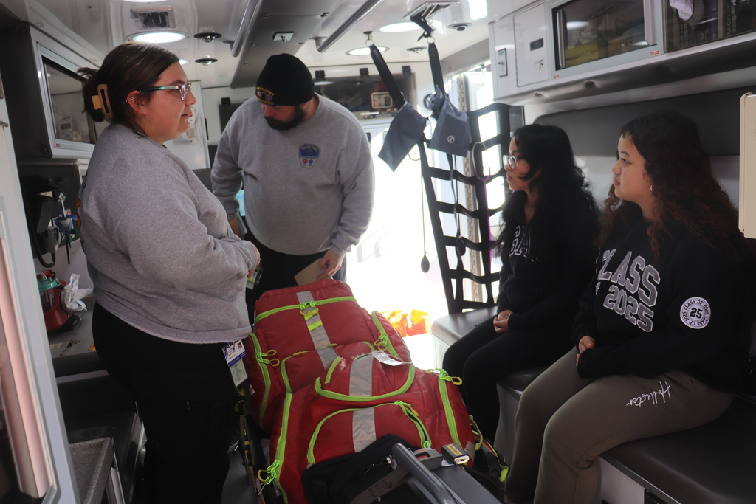


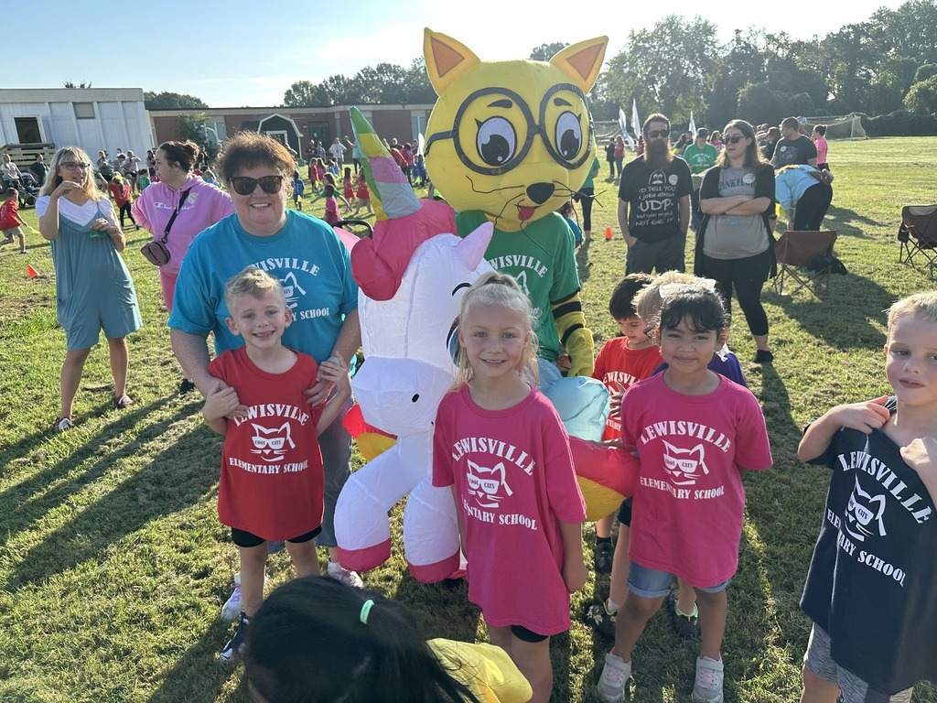
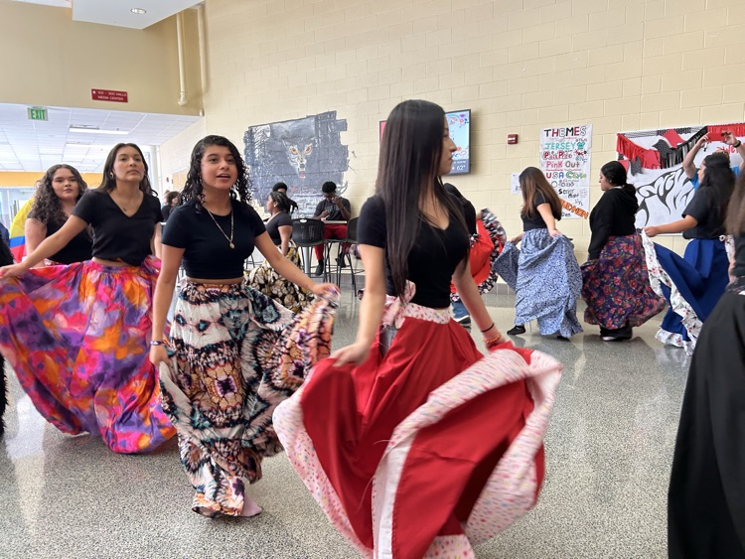
The Why Behind our Budget Request

Slide 58
Recommended Next Steps
Host series of meetings with stakeholders and launch a survey for input to determine the approach to saving13 million for FY2026
Host BOE workshop on 5/20 to discuss savings plan for additional savings in FY2026 as well as gain a better understanding of overages in FY2025 leading up to June 30. Also discuss plans for paying back any overages for FY2025.
Continue working with consulting firm to ensure processes, protocols and controls are in place to pay back any overages and stay within the budget proposal as interim CFO transitions
Plan opportunities for community feedback
Work closely with DPI to continue to monitor state spending
Work with state auditor to create data dashboard for transparency
CFO provide financial report at first full BOE meeting each month for the school board and public

Slide 59
Appendices

Slide 60
FY 2024 State, Local
&
Federal Expense
51

Slide 61
52

Slide 62
53

Slide 63
54

Slide 64
55

